Slide 1
Linkage and phasing in polyploids
Marcelo Mollinari
mmollin@ncsu.edu
SCRI Workshop – January 14, 2021
This work is licensed under CC BY 4.0

Slide 2
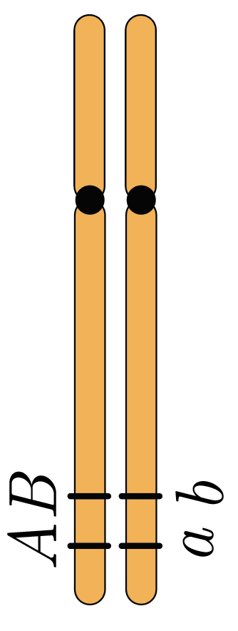
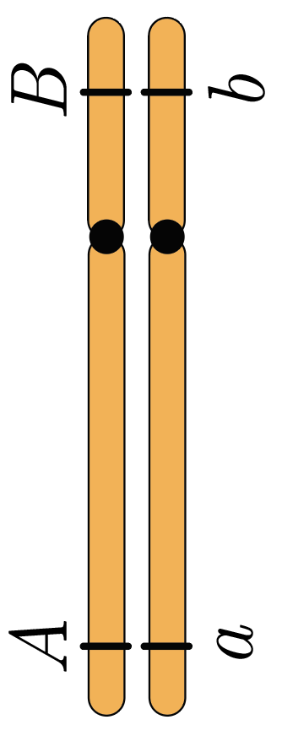
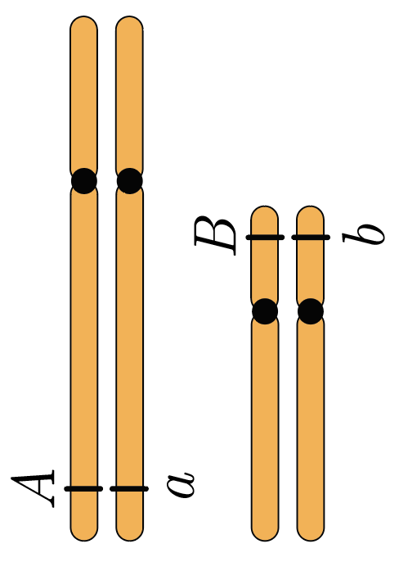
Introduction
Genetic linkage is the phenomenon where markers are likely to be inherited together.
The closer the markers are, the lower the probability of crossing over events occur between them; consequently, the more likely they will be co-inherited.
Linked
Not linked
Not linked
How can we measure how likely A and B are co-inherited?

Slide 3
Linkage analysis
Genetic linkage is a concept applied to at least two loci.
We measure linkage using the recombination frequency (or fraction) in a segregation population.
Recombination frequency is the probability that an odd number of crossovers occurs between the markers. Ranges from 0.0 to 0.5 (considering double reduction this number can be higher)
We can transform these probabilistic values into distances using mapping functions. (Morgan, Haldane, Kosambi, etc.)
By computing the recombination frequencies between pairs of markers and using mapping functions, we can construct linkage maps which show the linear order and relative distance between adjacent markers.
First, let us address the behavior o a single loci when transited across generations.

Slide 4
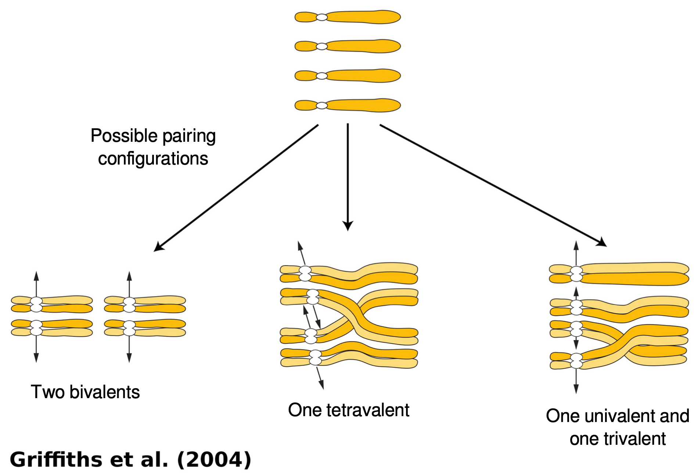
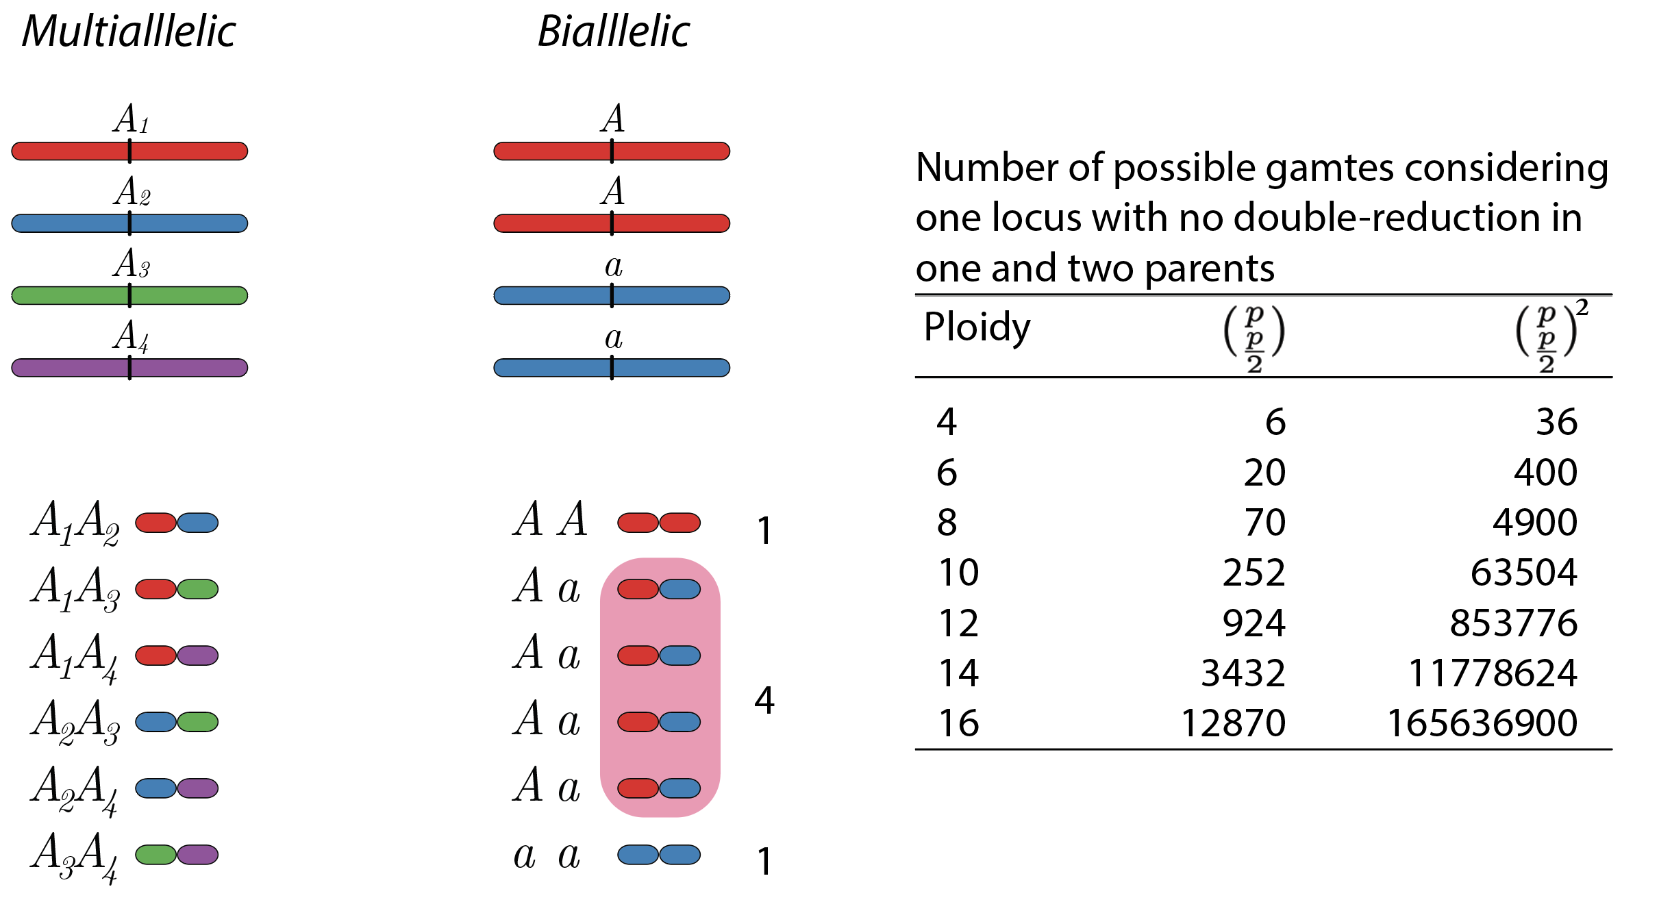
Gamete formation in polyploids*
*random pairing and no double reduction

Slide 5
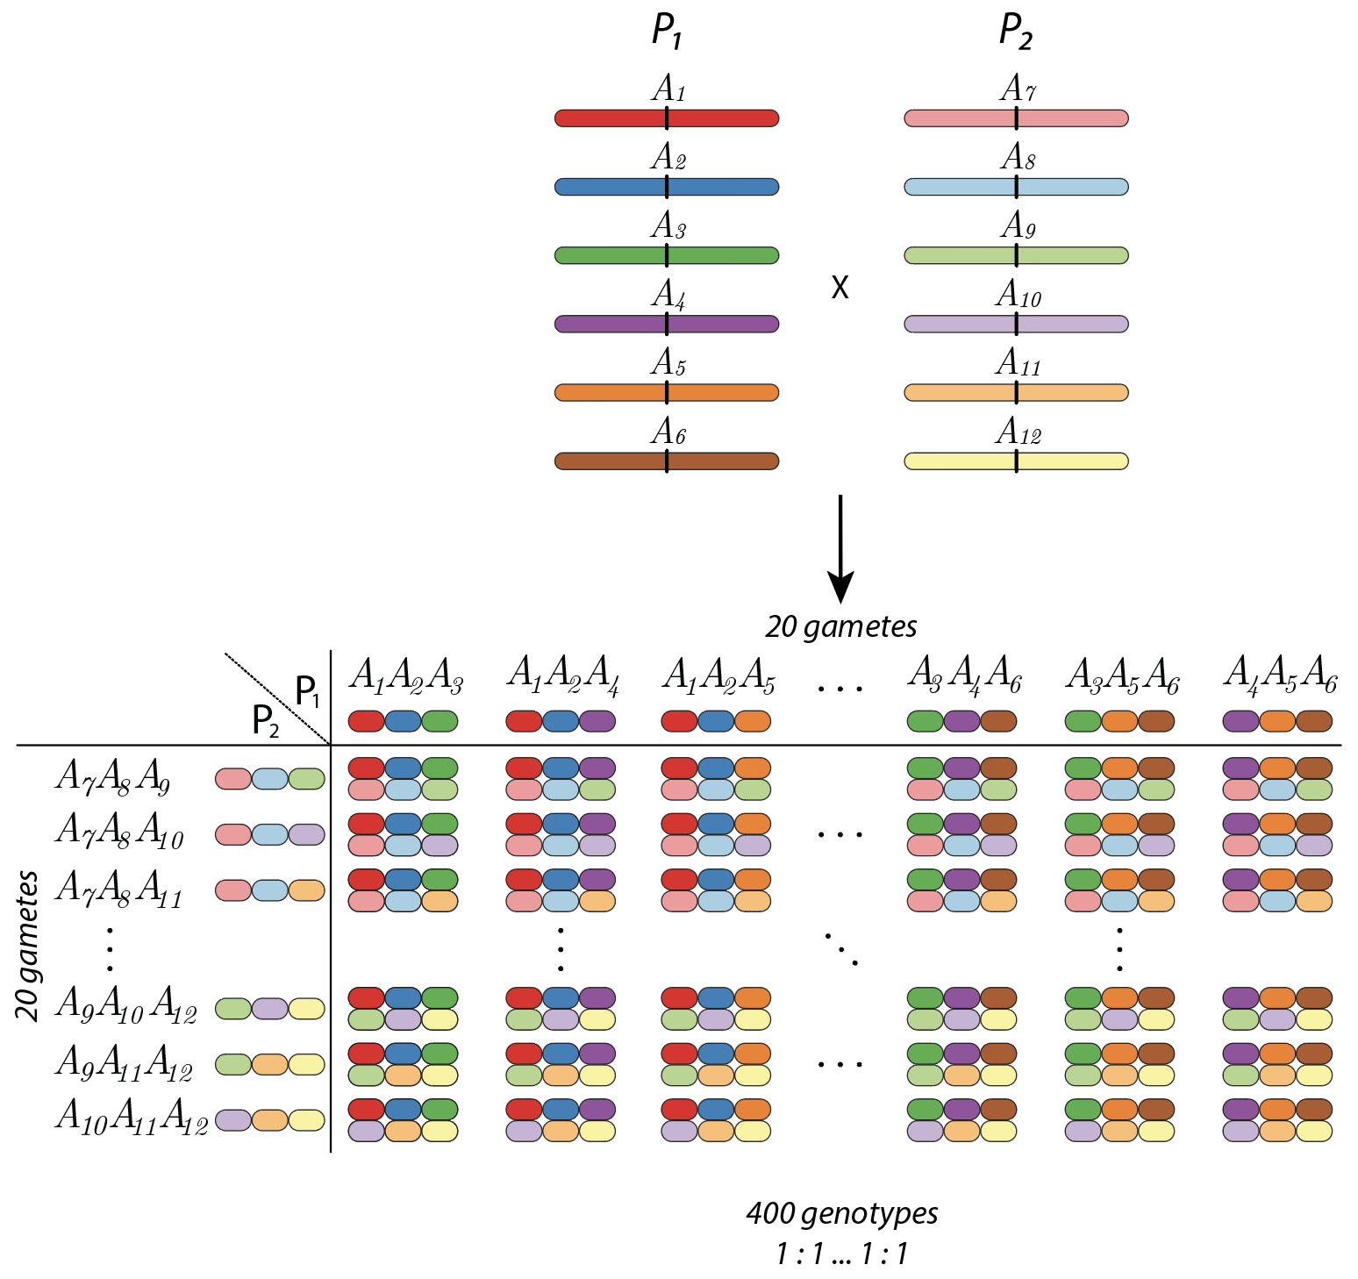
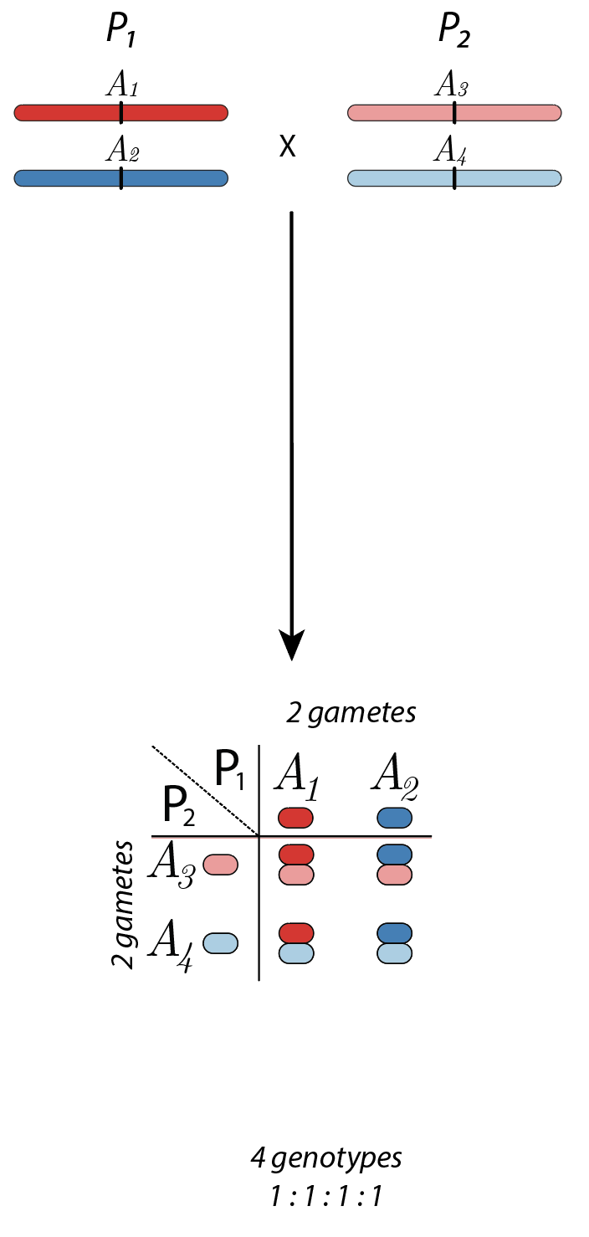
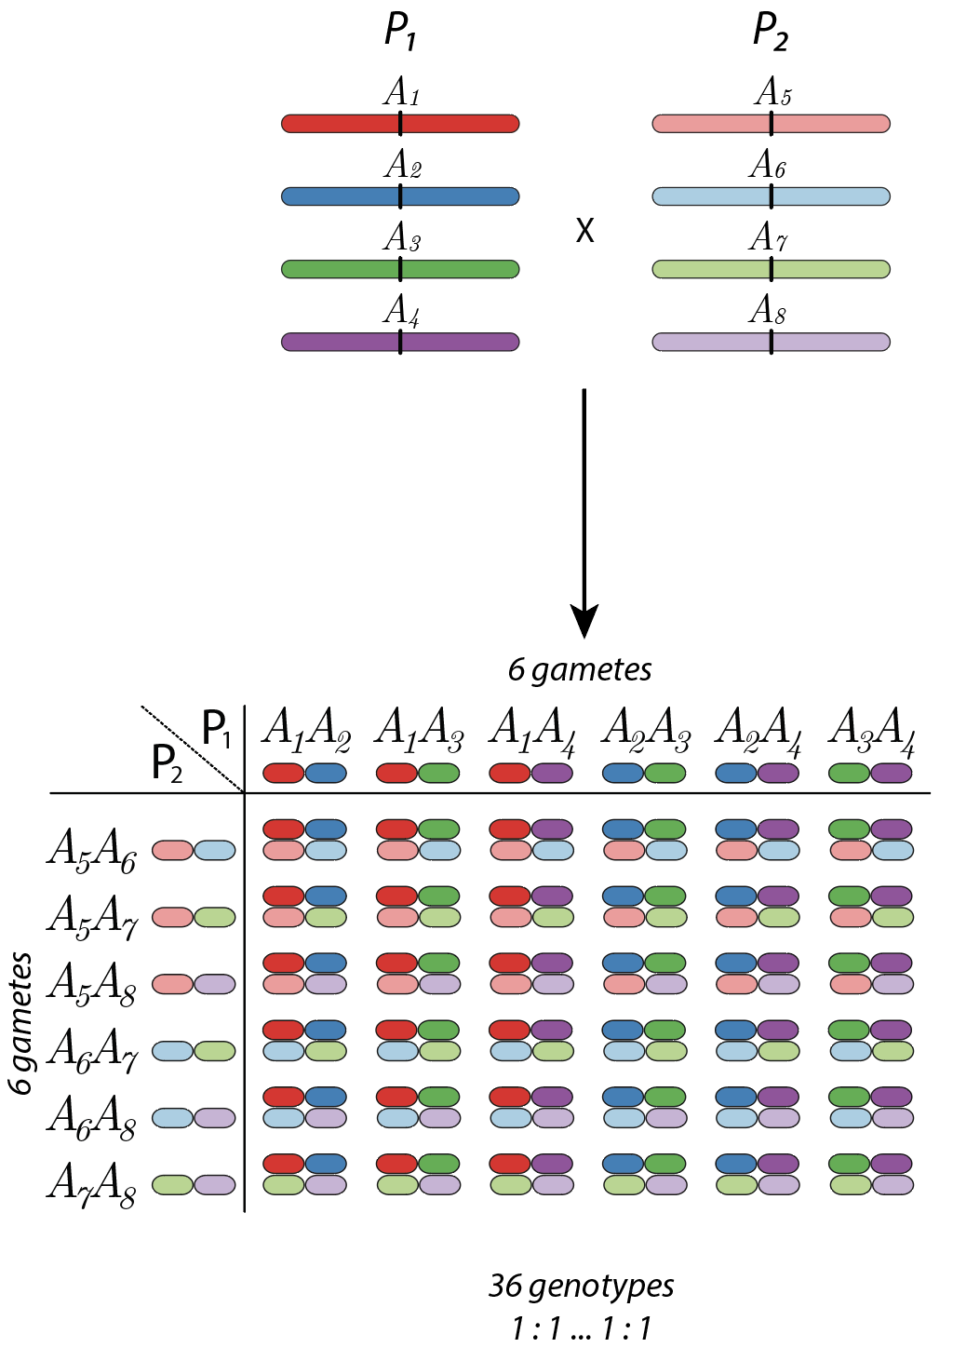
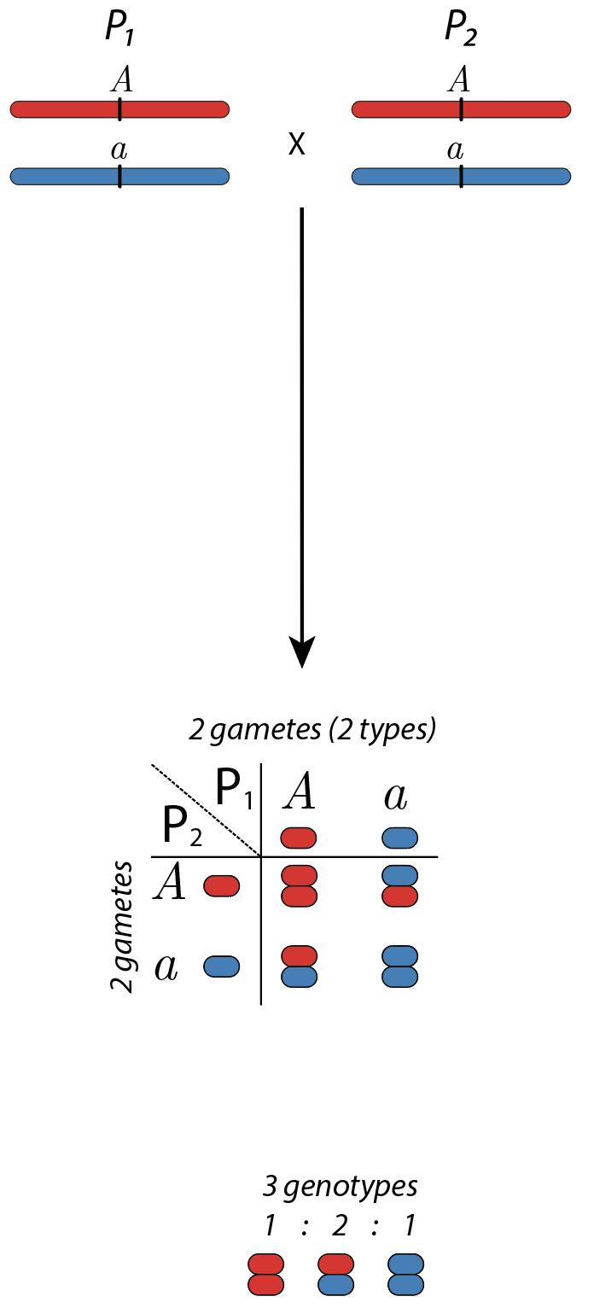
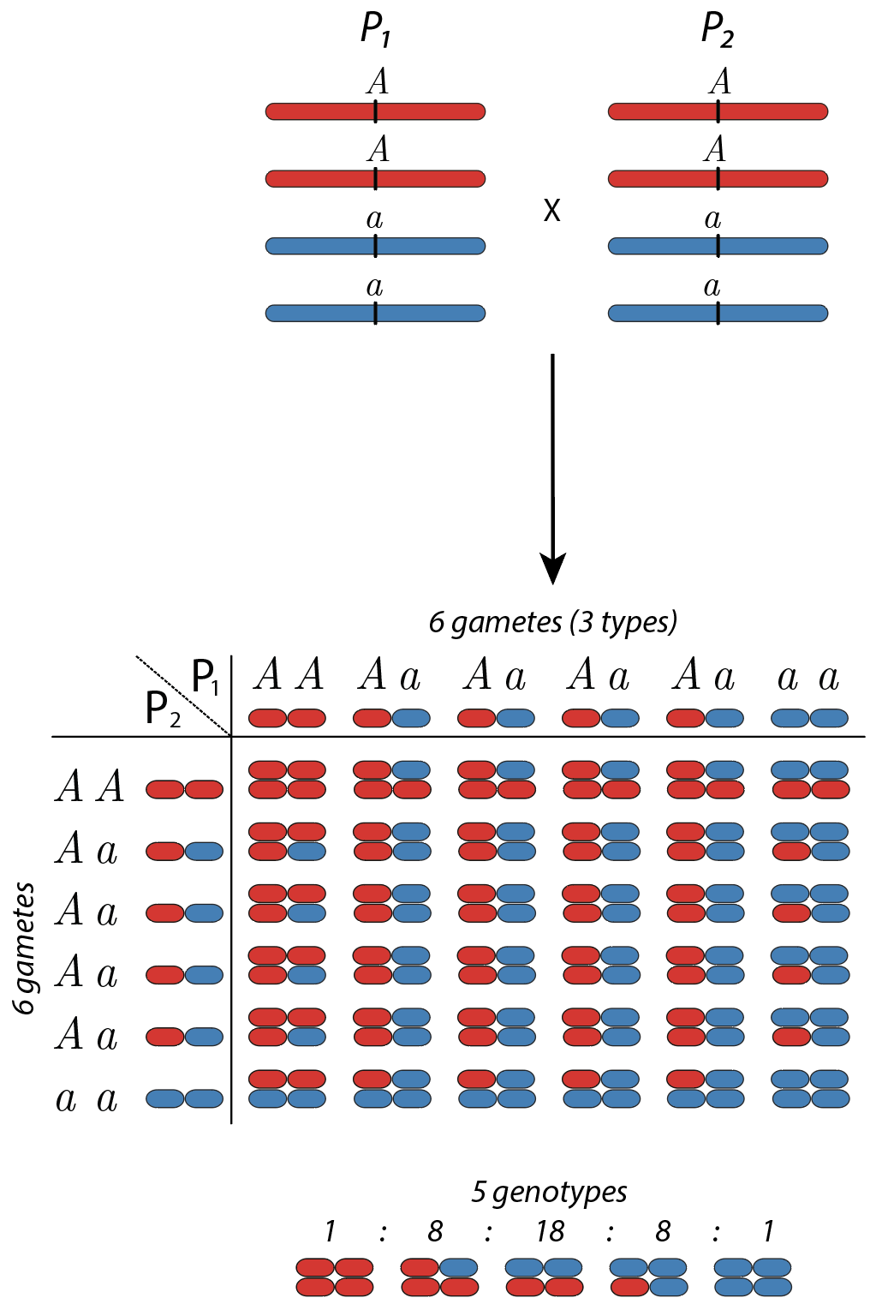
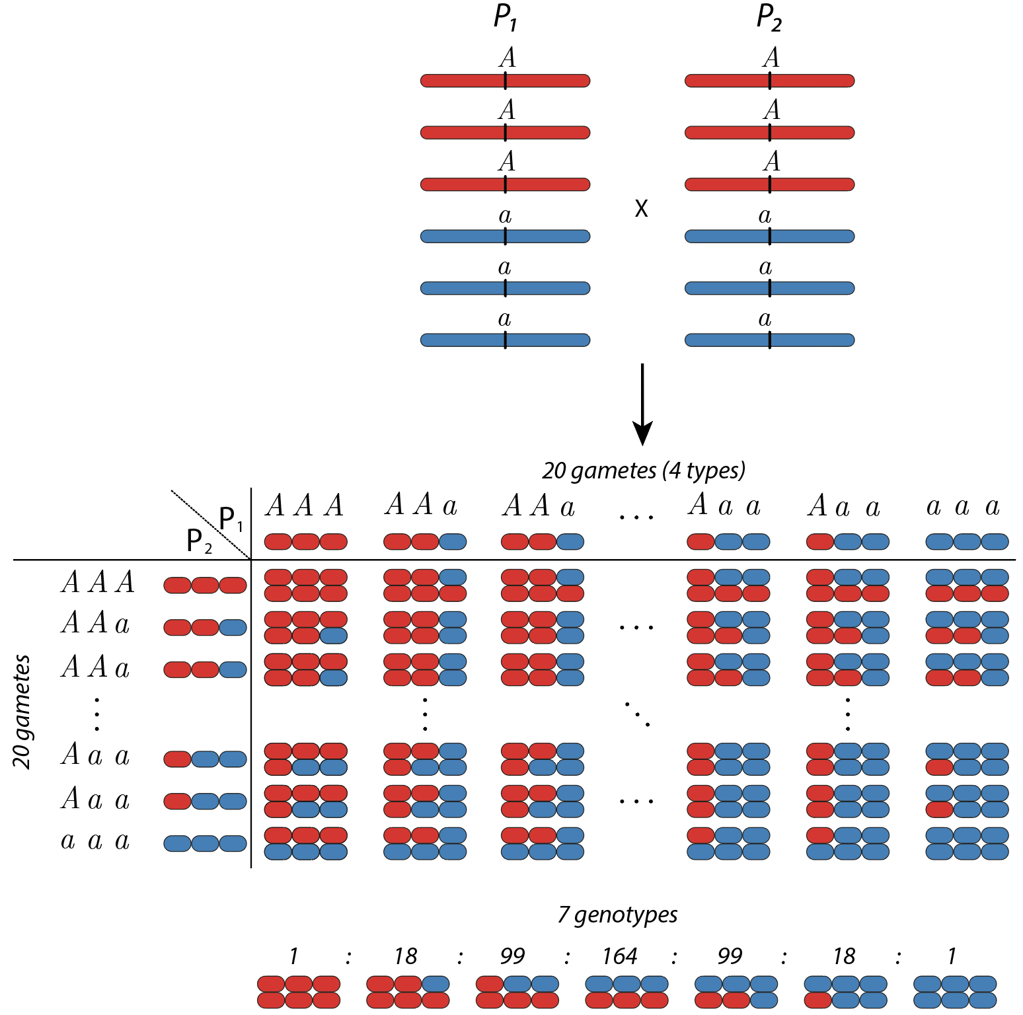
Segregation in polyploids*
Hexaploid
Diploid
Tetraploid
Multiallelic
Biallelic
*random pairing and no double reduction

Slide 6
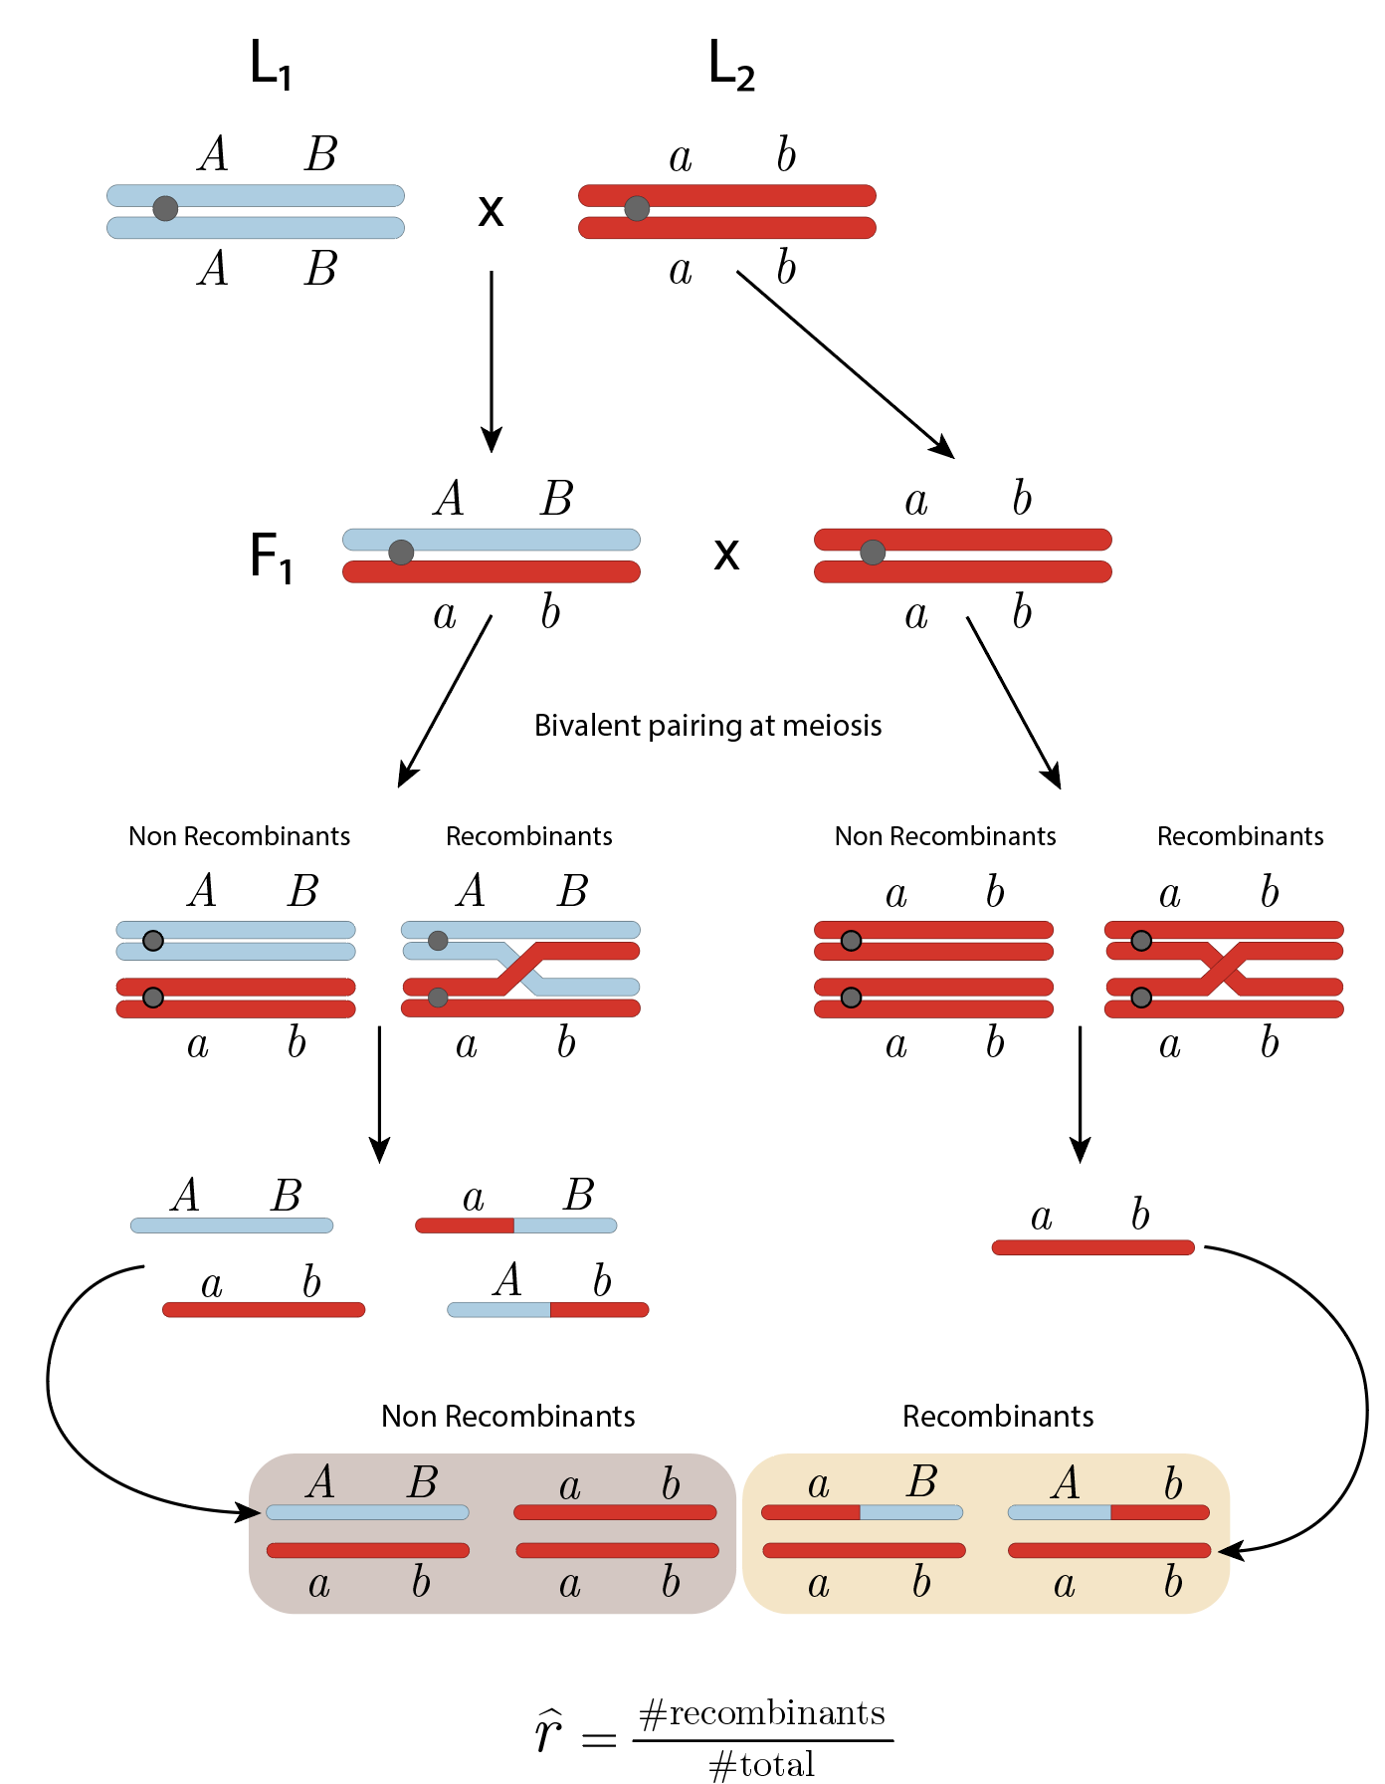
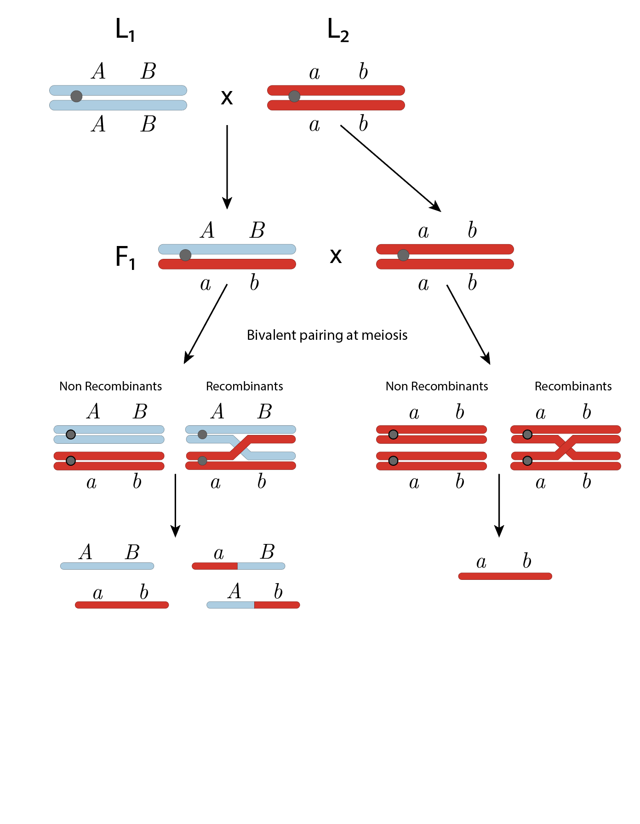
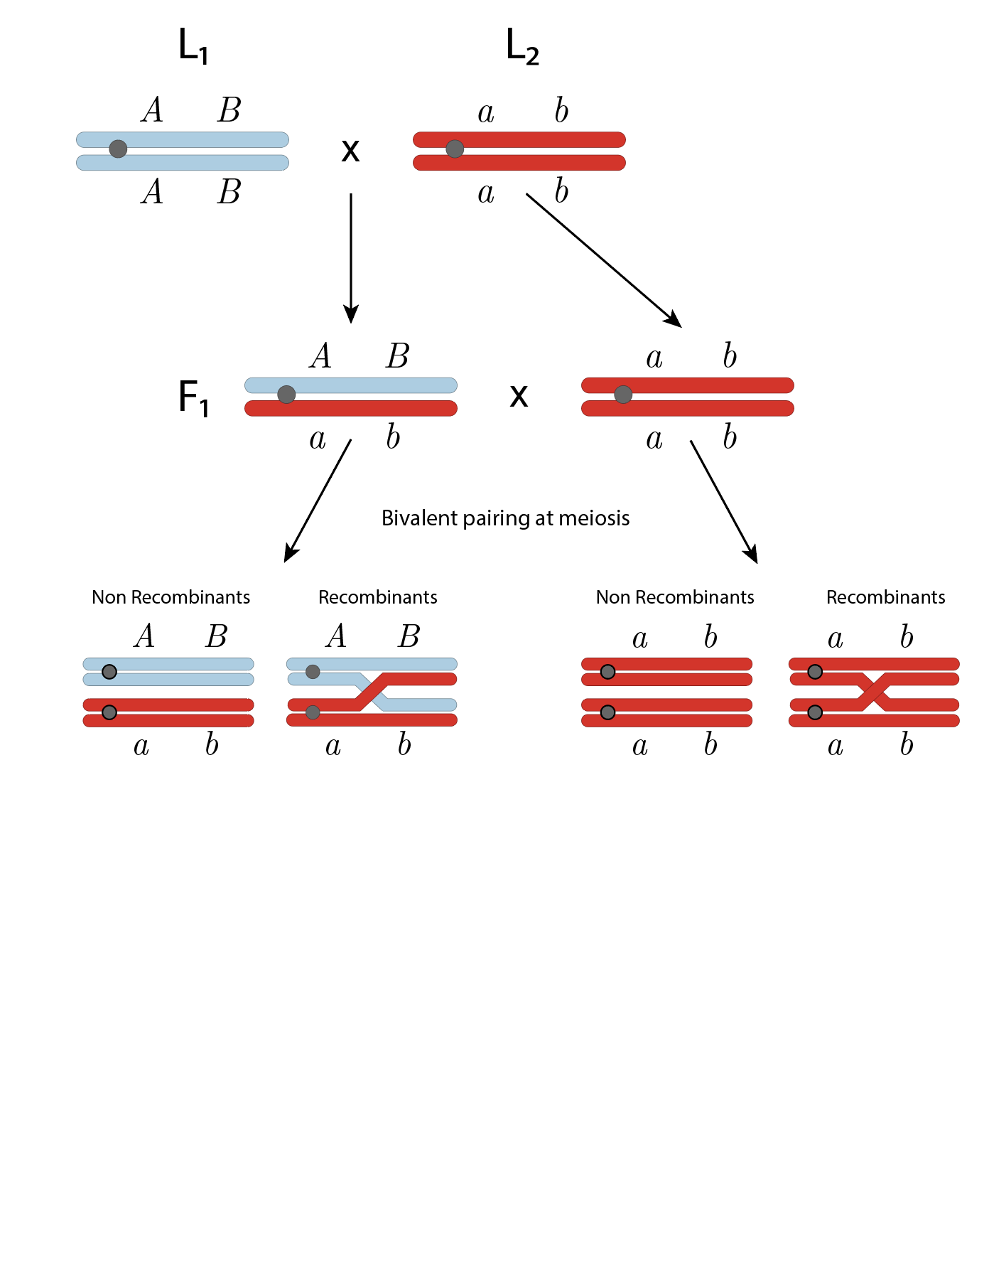
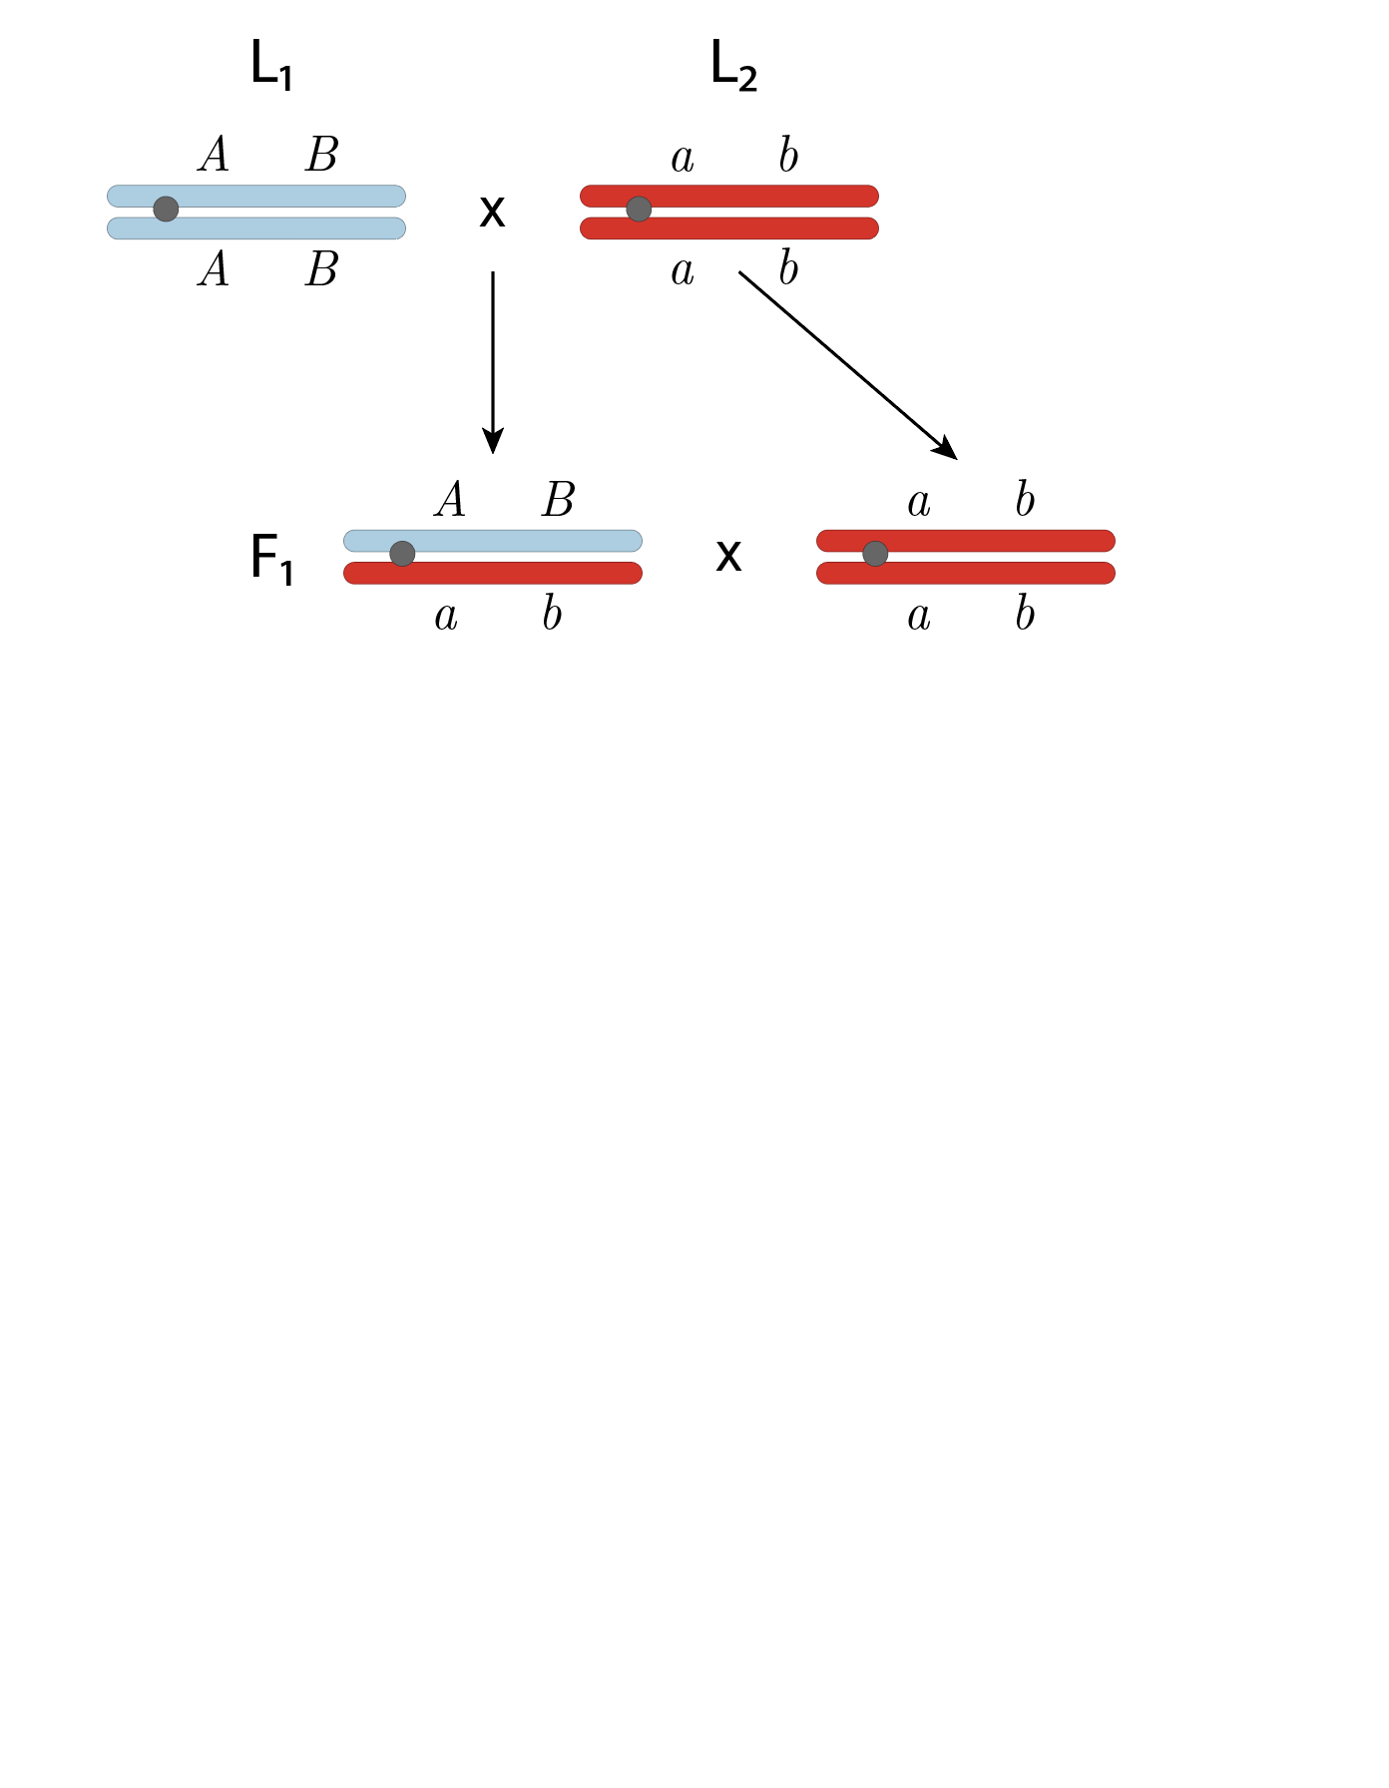
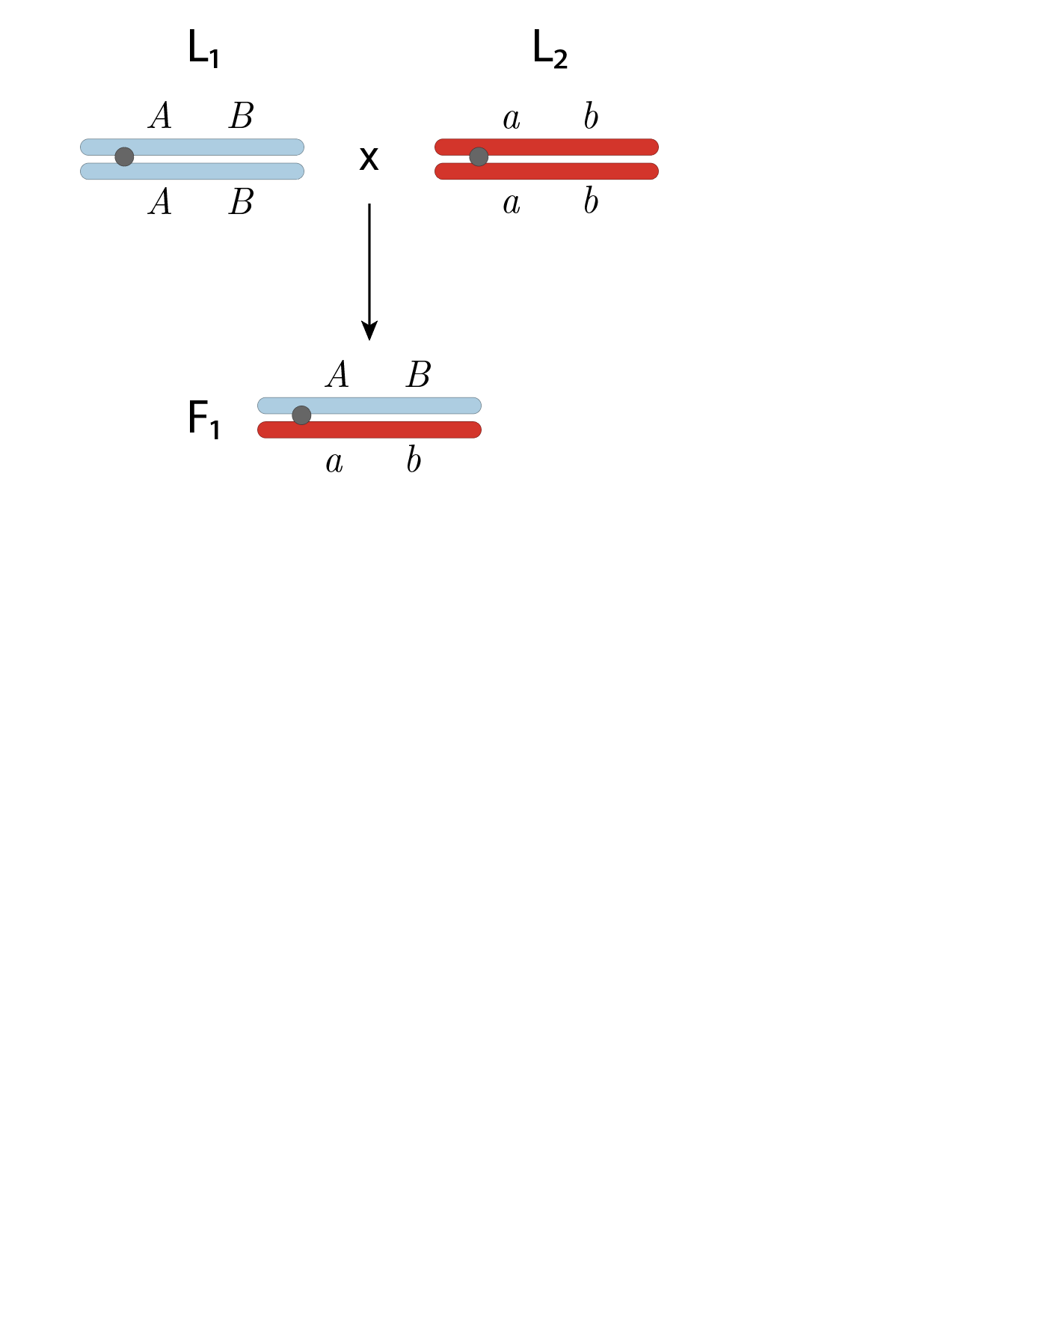
Recombination fraction in diploids

Slide 7
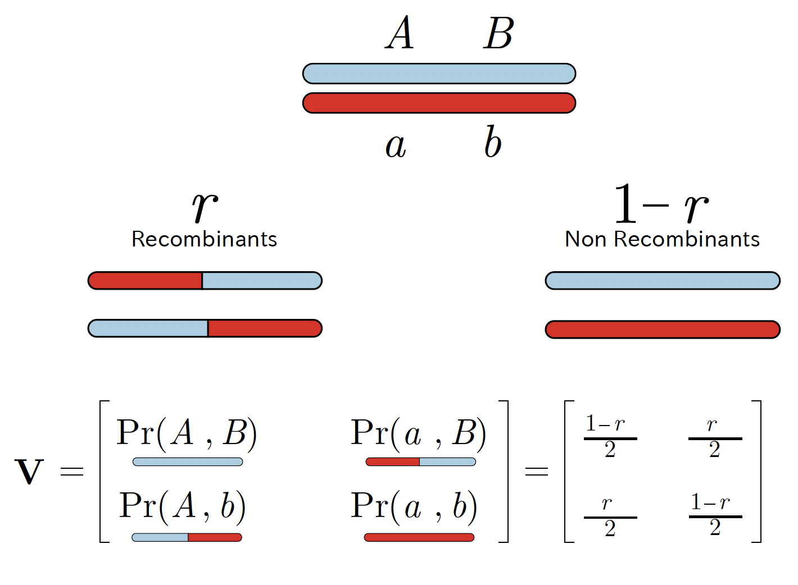
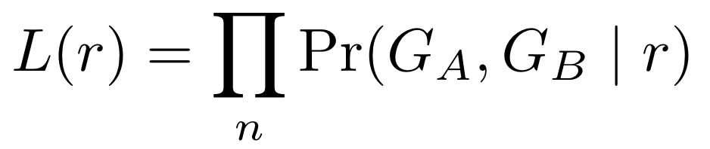
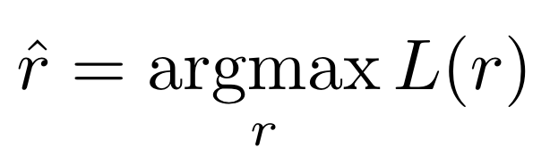
Recombination fraction in diploids - Likelihood
where n is the number of individuals. The maximum likelihood estimator of r is

Slide 8
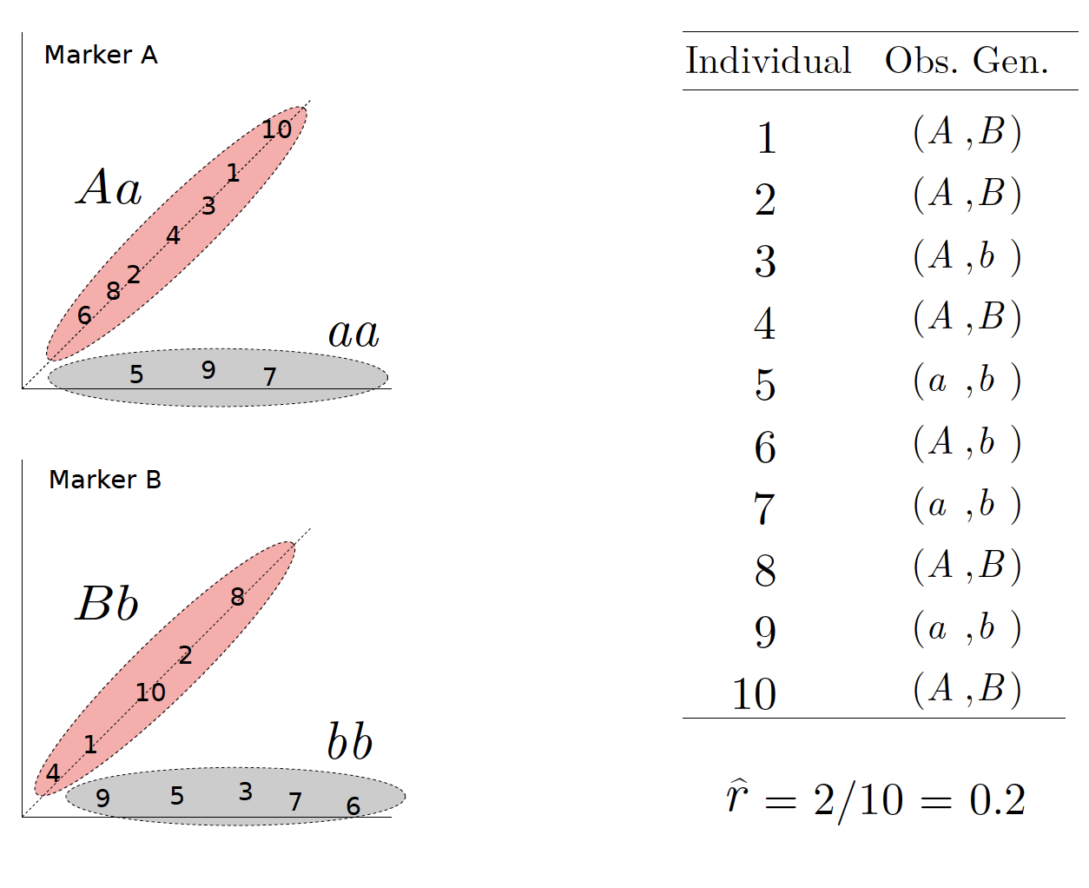
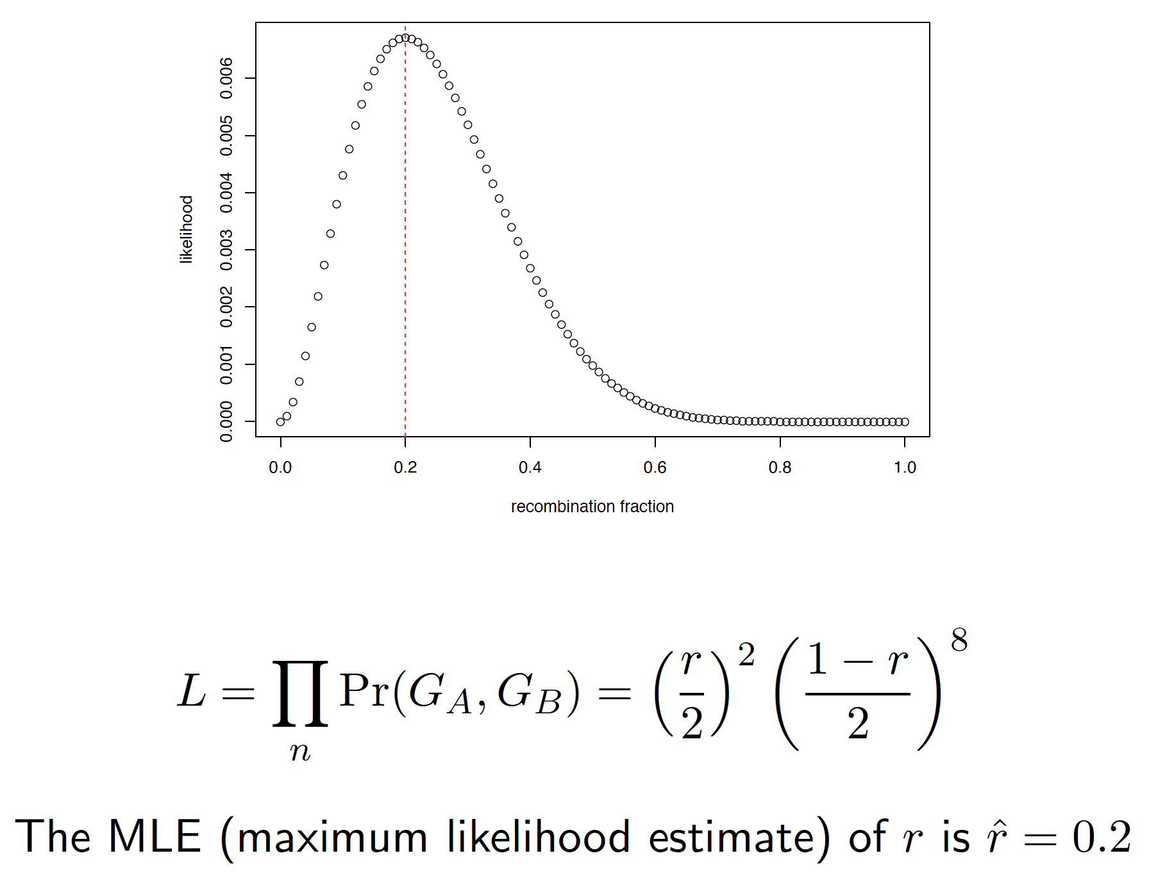
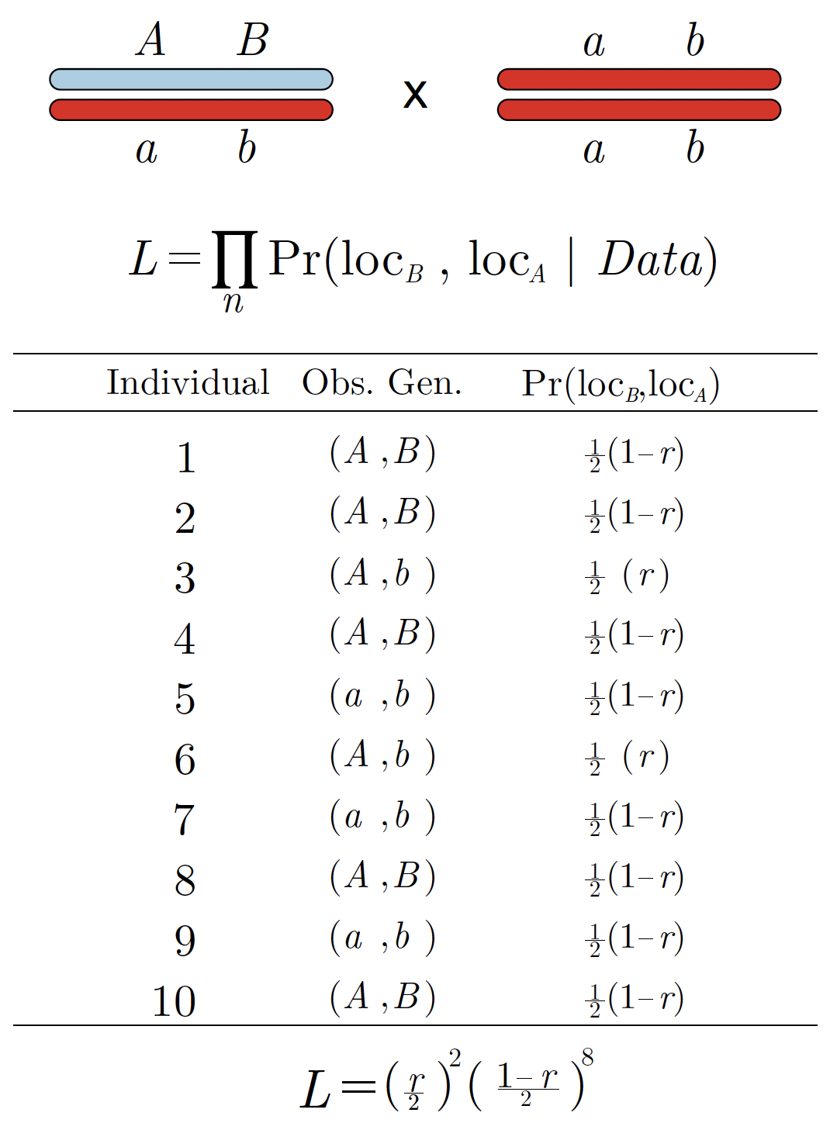
Recombination fraction in diploids
Toy example
Computing recombination frequencies in diploids using R and C++
https://github.com/mmollina/Cpp_and_R

Slide 9
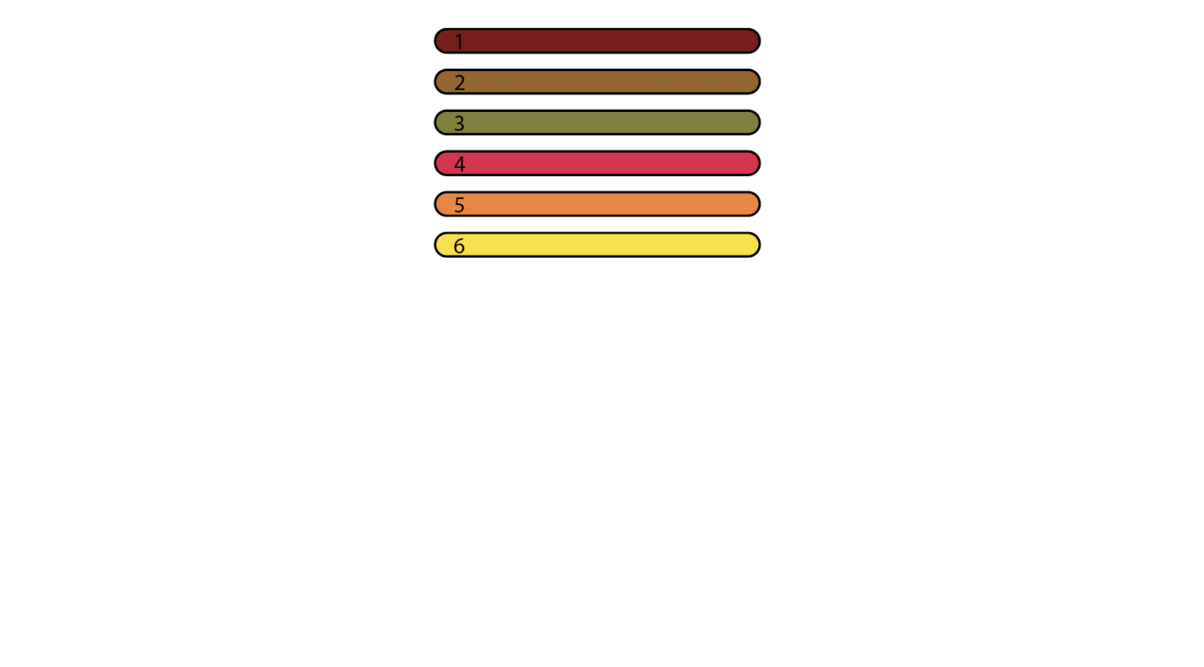
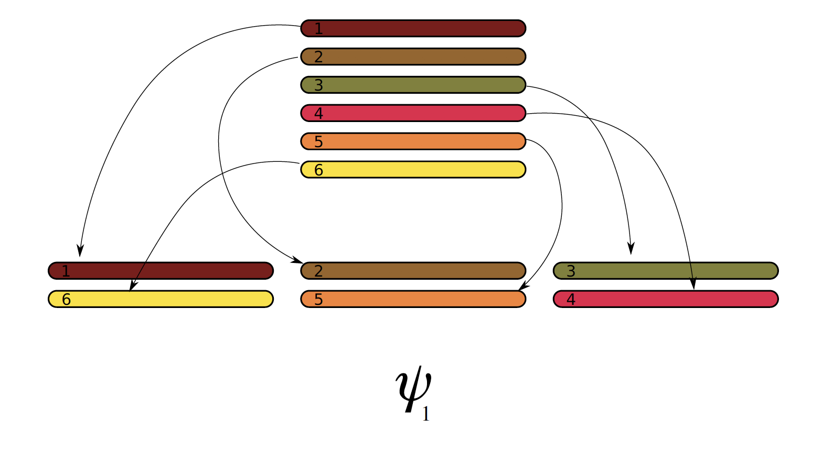
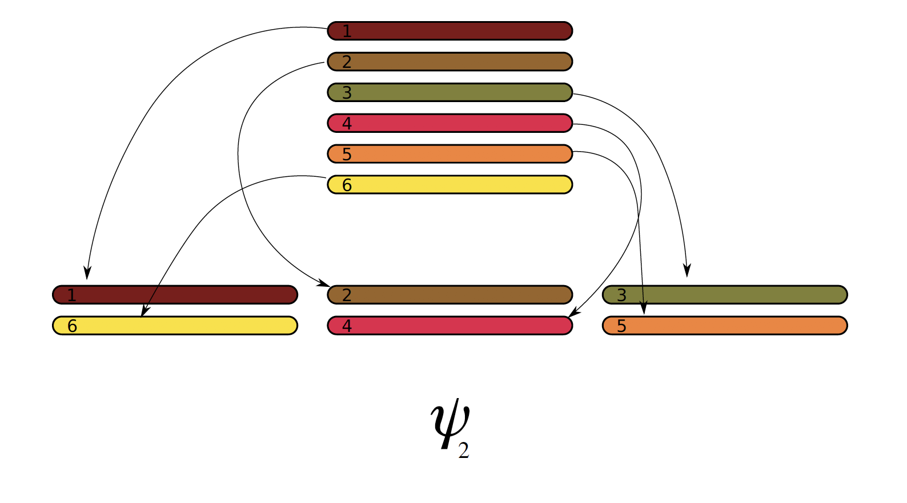
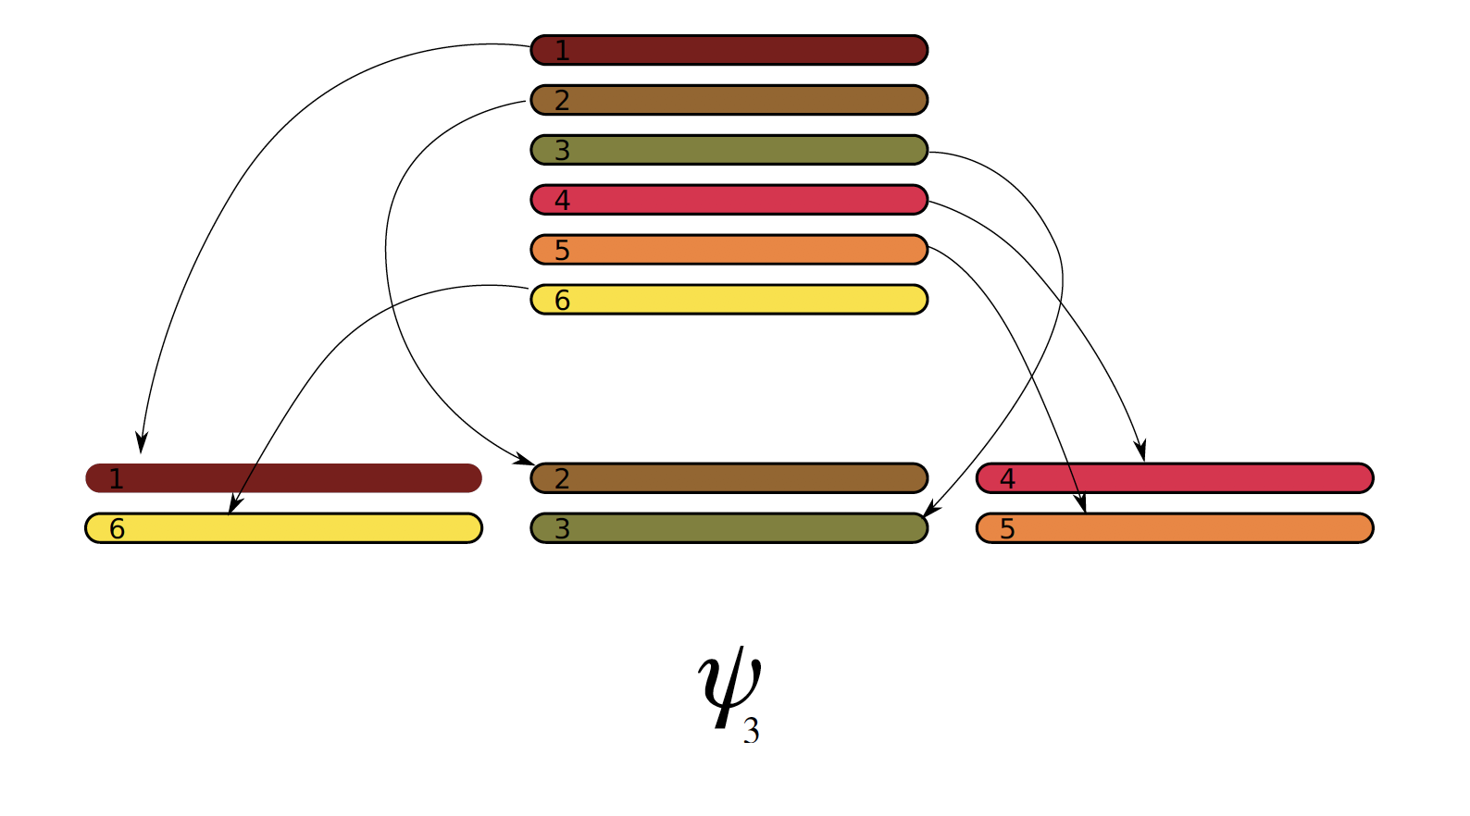
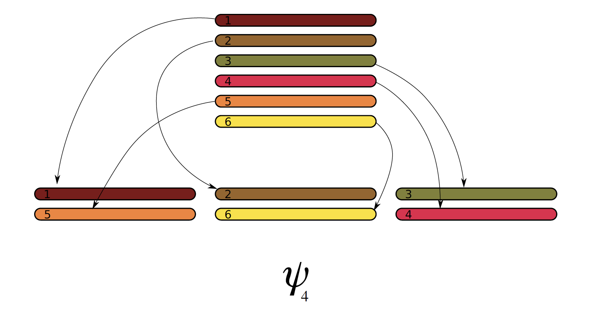
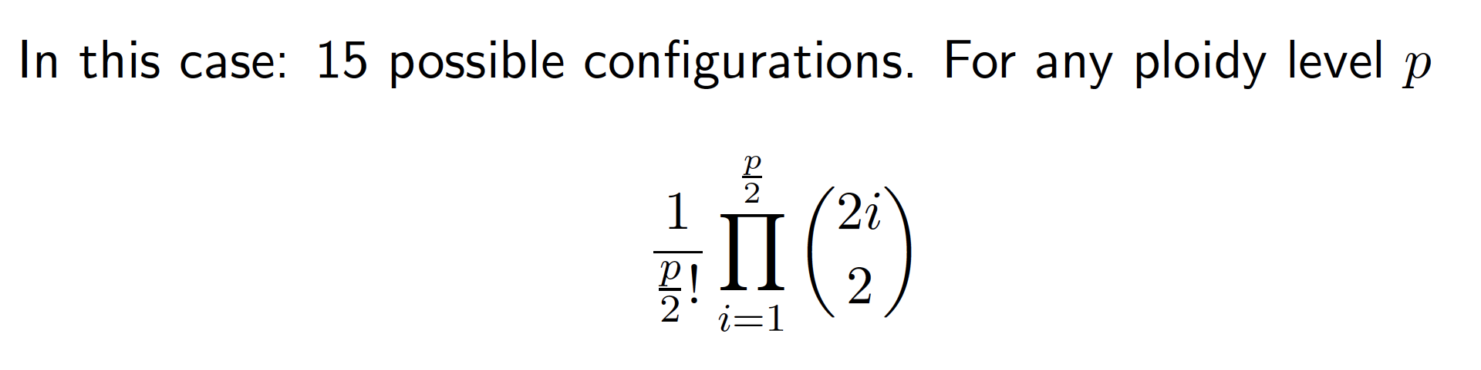
Gamete formation in polyploids*
*no double reduction

Slide 10
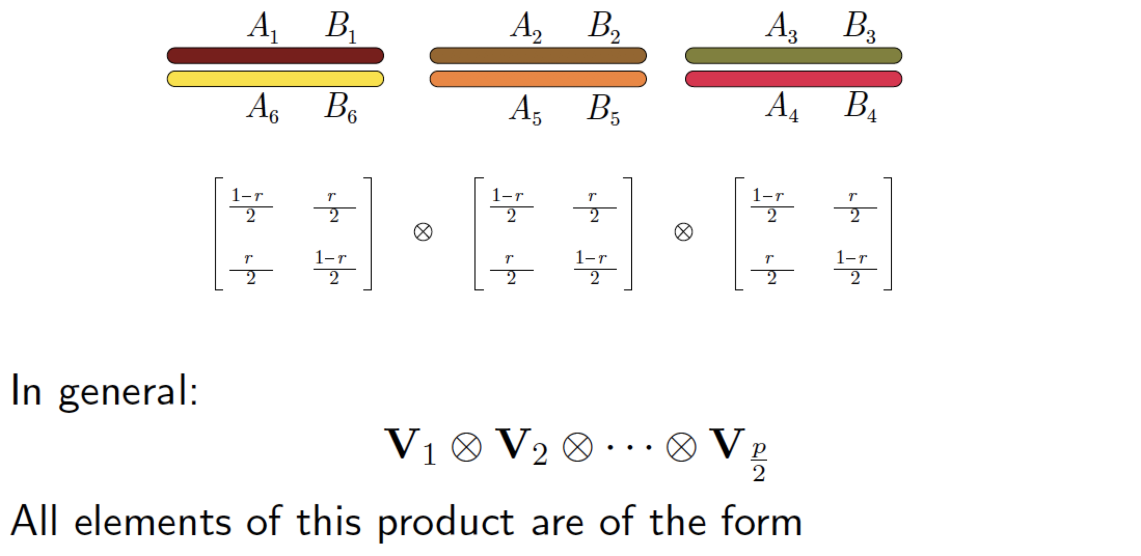
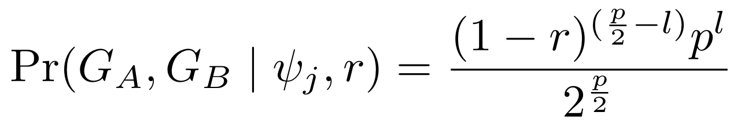
Expected gametic frequency given a bivalent configuration
l : known number of recombinant bivalents between loci A and B

Slide 11
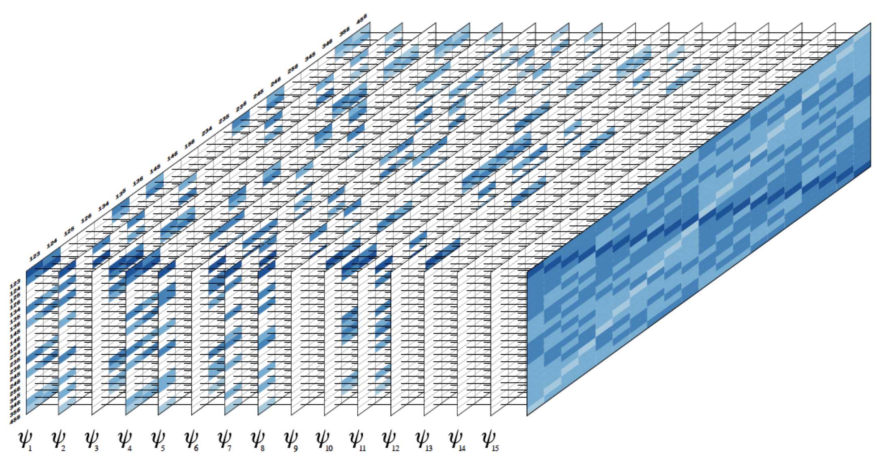
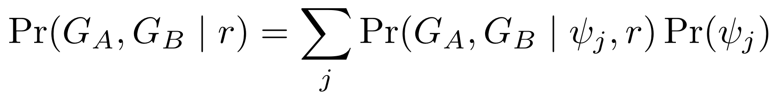
Unconditional gametic probability
Mollinari and Garcia (2019) doi:10.1534/g3.119.400378

Slide 12
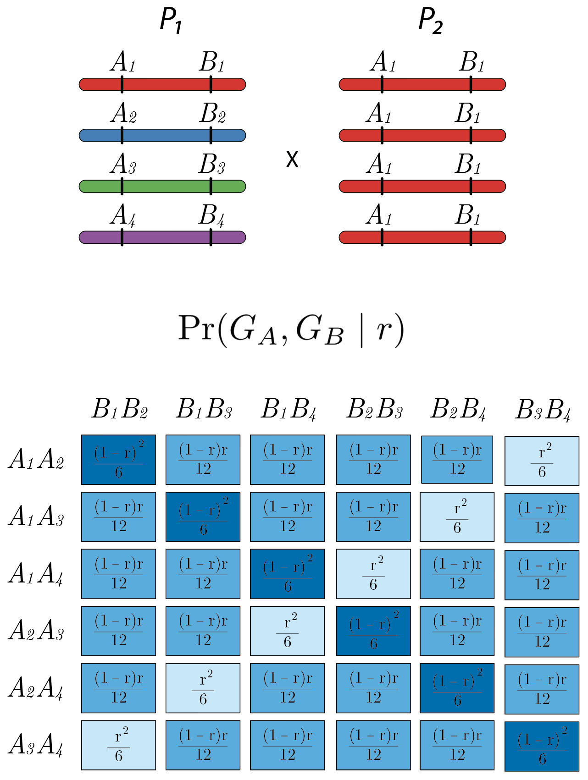
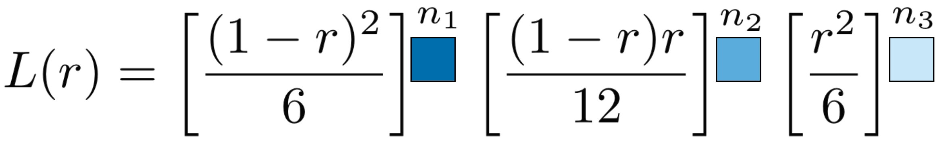
Recombination Fraction – autotetraploid
Fully informative marker

Slide 13
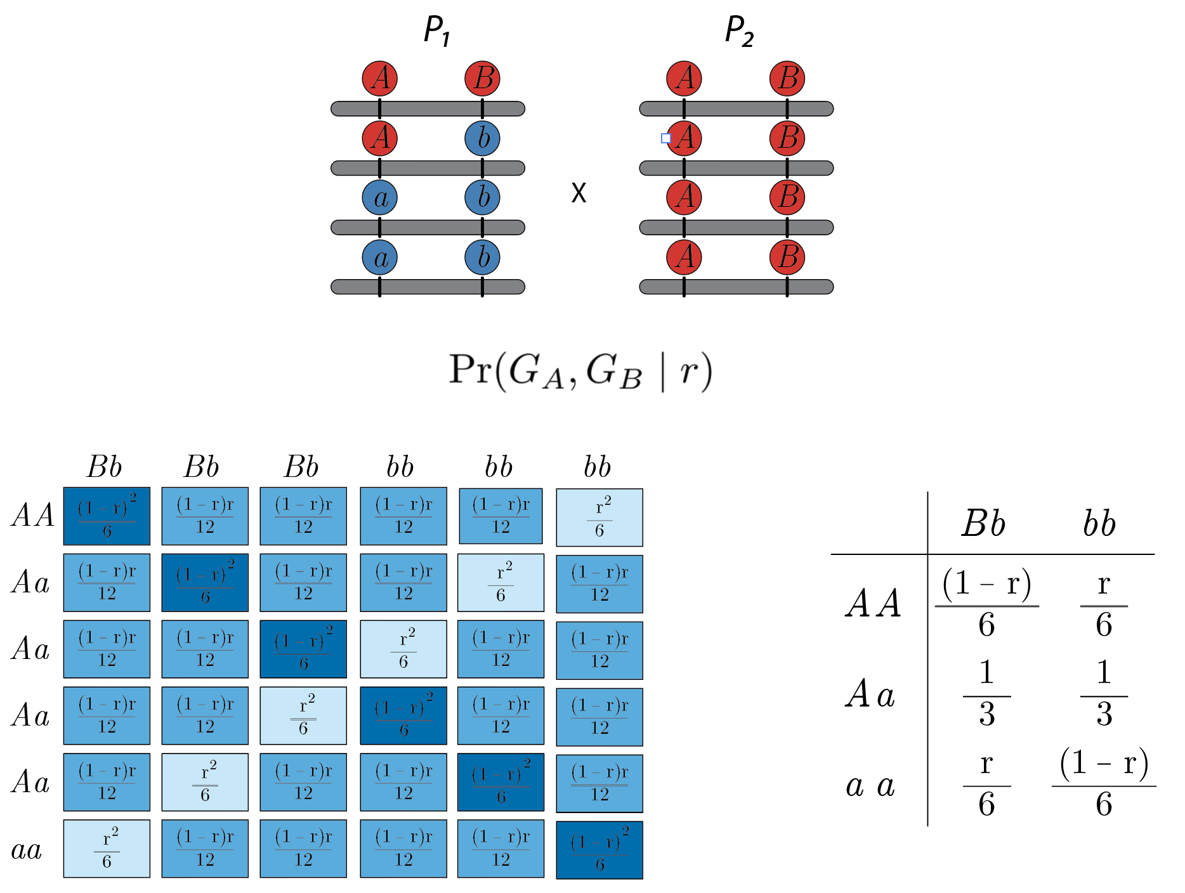
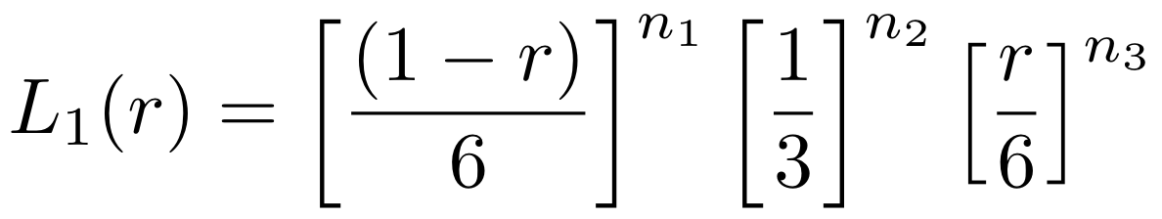
Recombination Fraction – autotetraploid
Partially informative marker – Duplex/simplex – Association

Slide 14
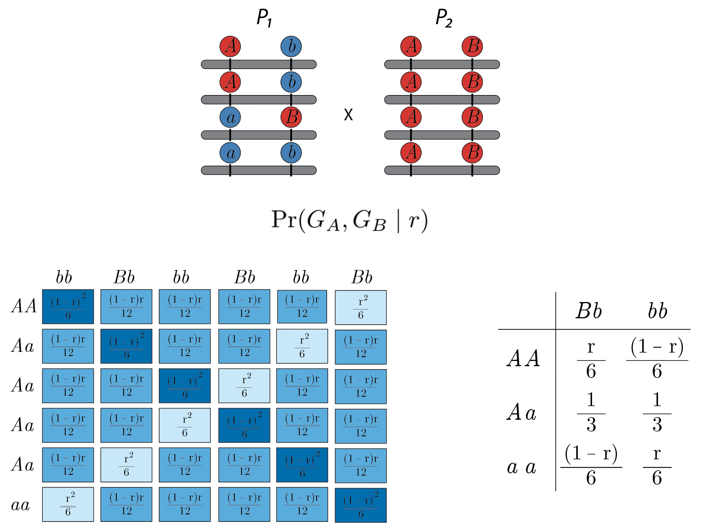
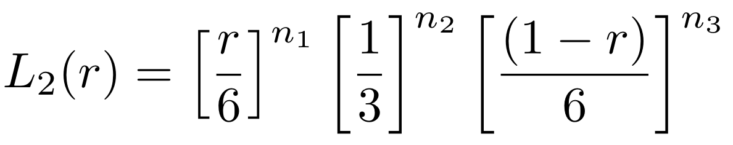
Recombination Fraction – autotetraploid
Partially informative marker – Duplex/simplex – Repulsion

Slide 15
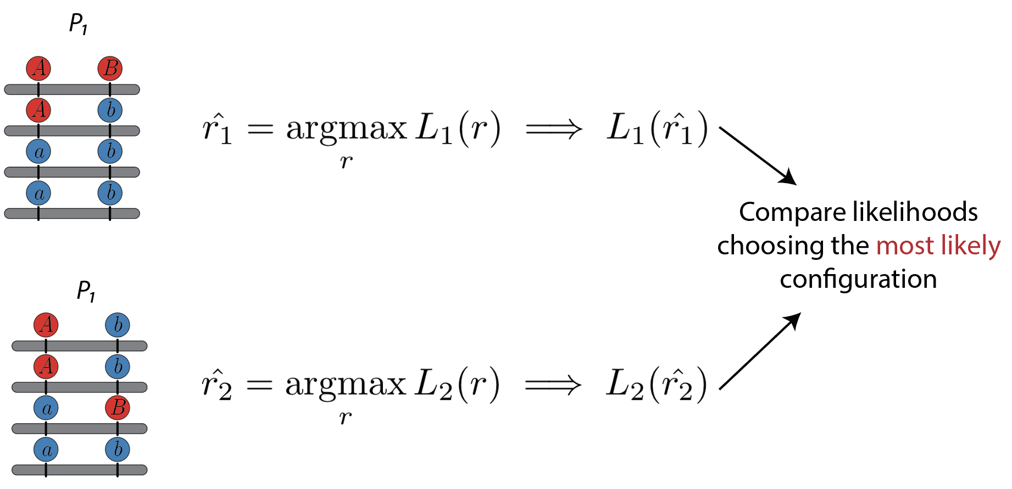
Recombination Fraction – assessing linkage phases
Pairwise MLE of r are used to group markers into linkage groups and order markers within each linkage group using optimization algorithms such as MDS
Given a sequence of ordered markers, it is possible to extend the idea of comparing likelihoods of competing linkage phases throughout multiple markers

Slide 16
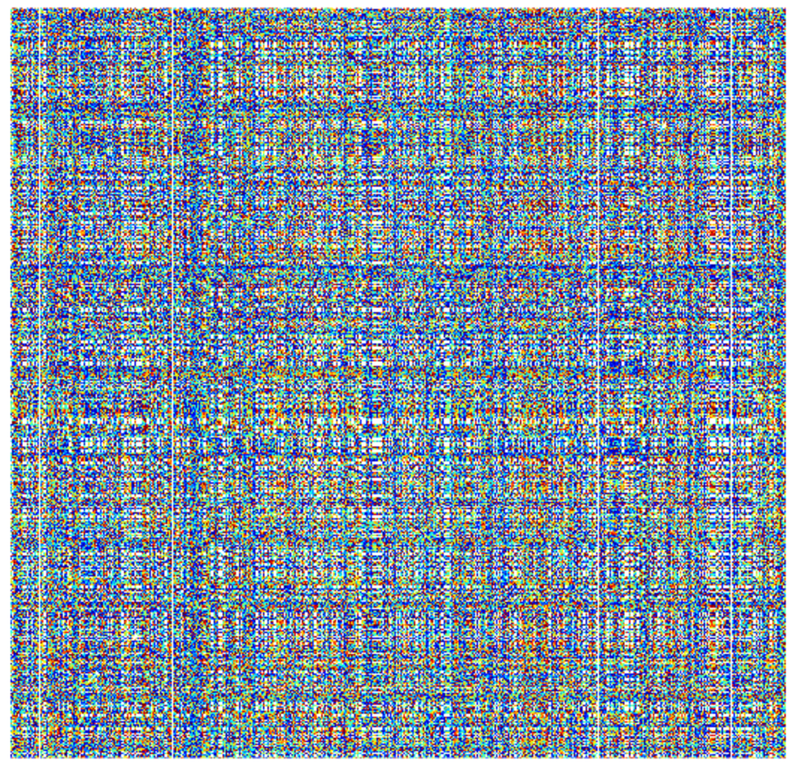
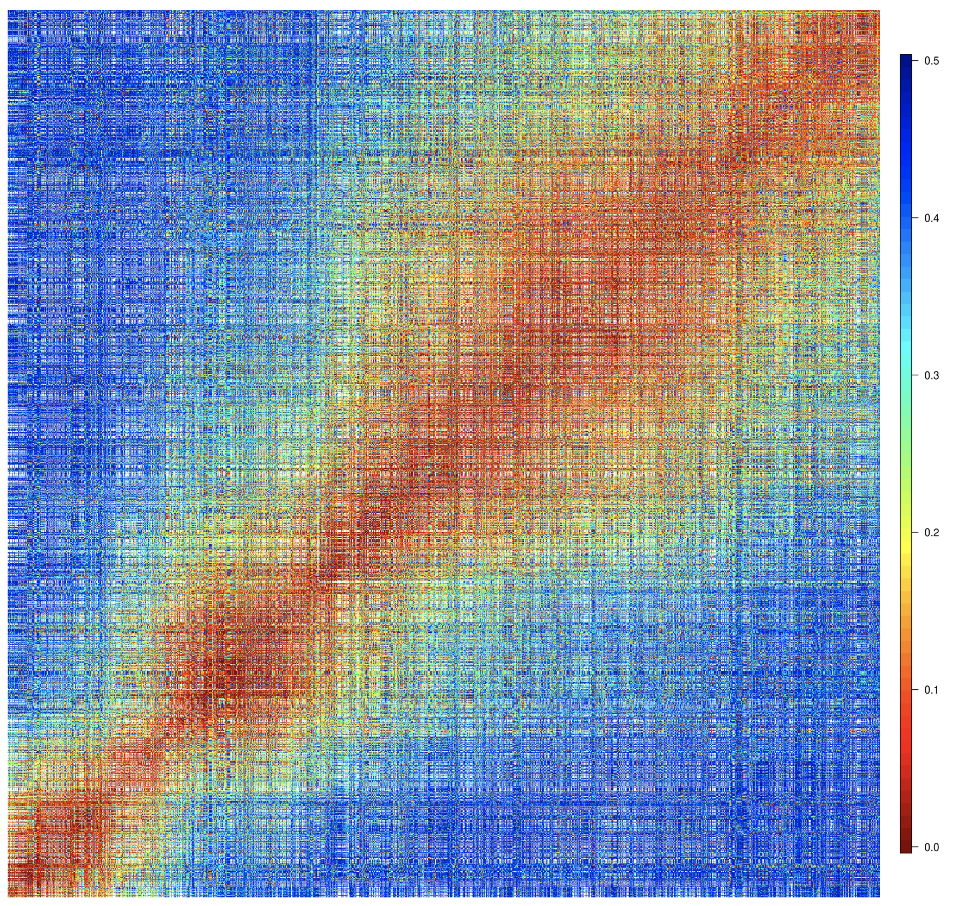
Multidimensional Scaling Algorithm (MDS)
Reduce data from many dimensions preserving the observed distances between points by minimizing a loss function L.
Sweetpotato linkage group 1: 2745 markers
Preedy and Hackett, 2016

Slide 17
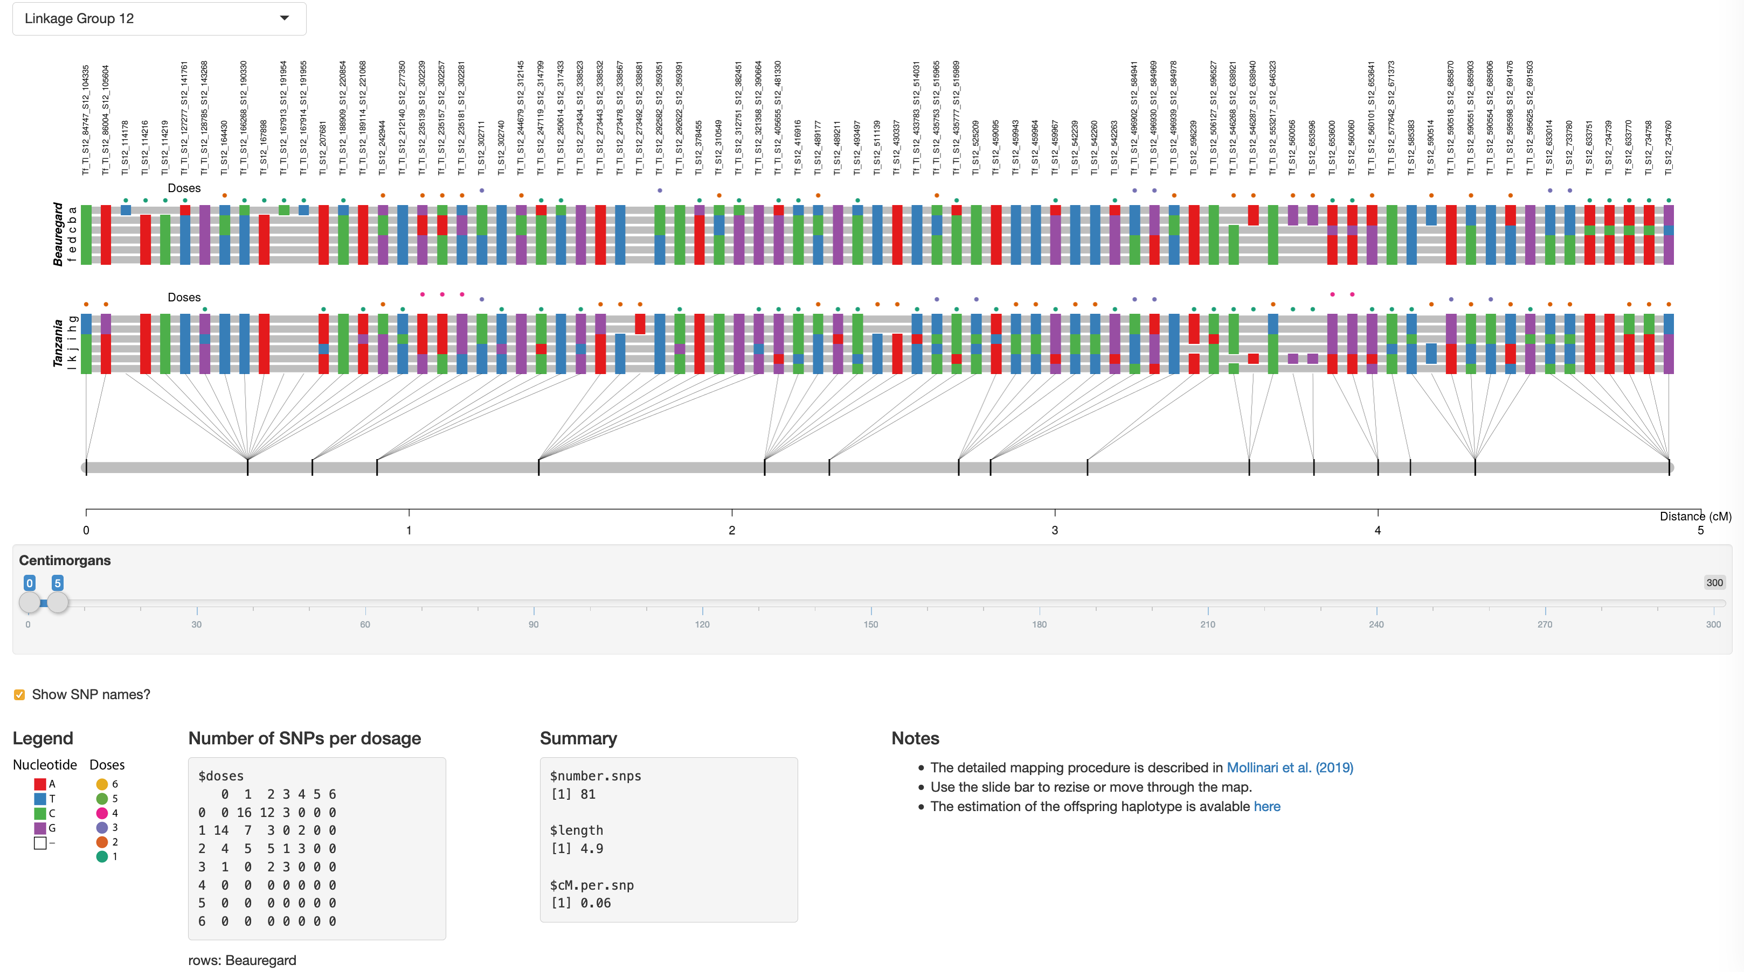

Haplotyping in polyploids
Disposition of allelic variants in the homologs in a homology group
dosages

Slide 18
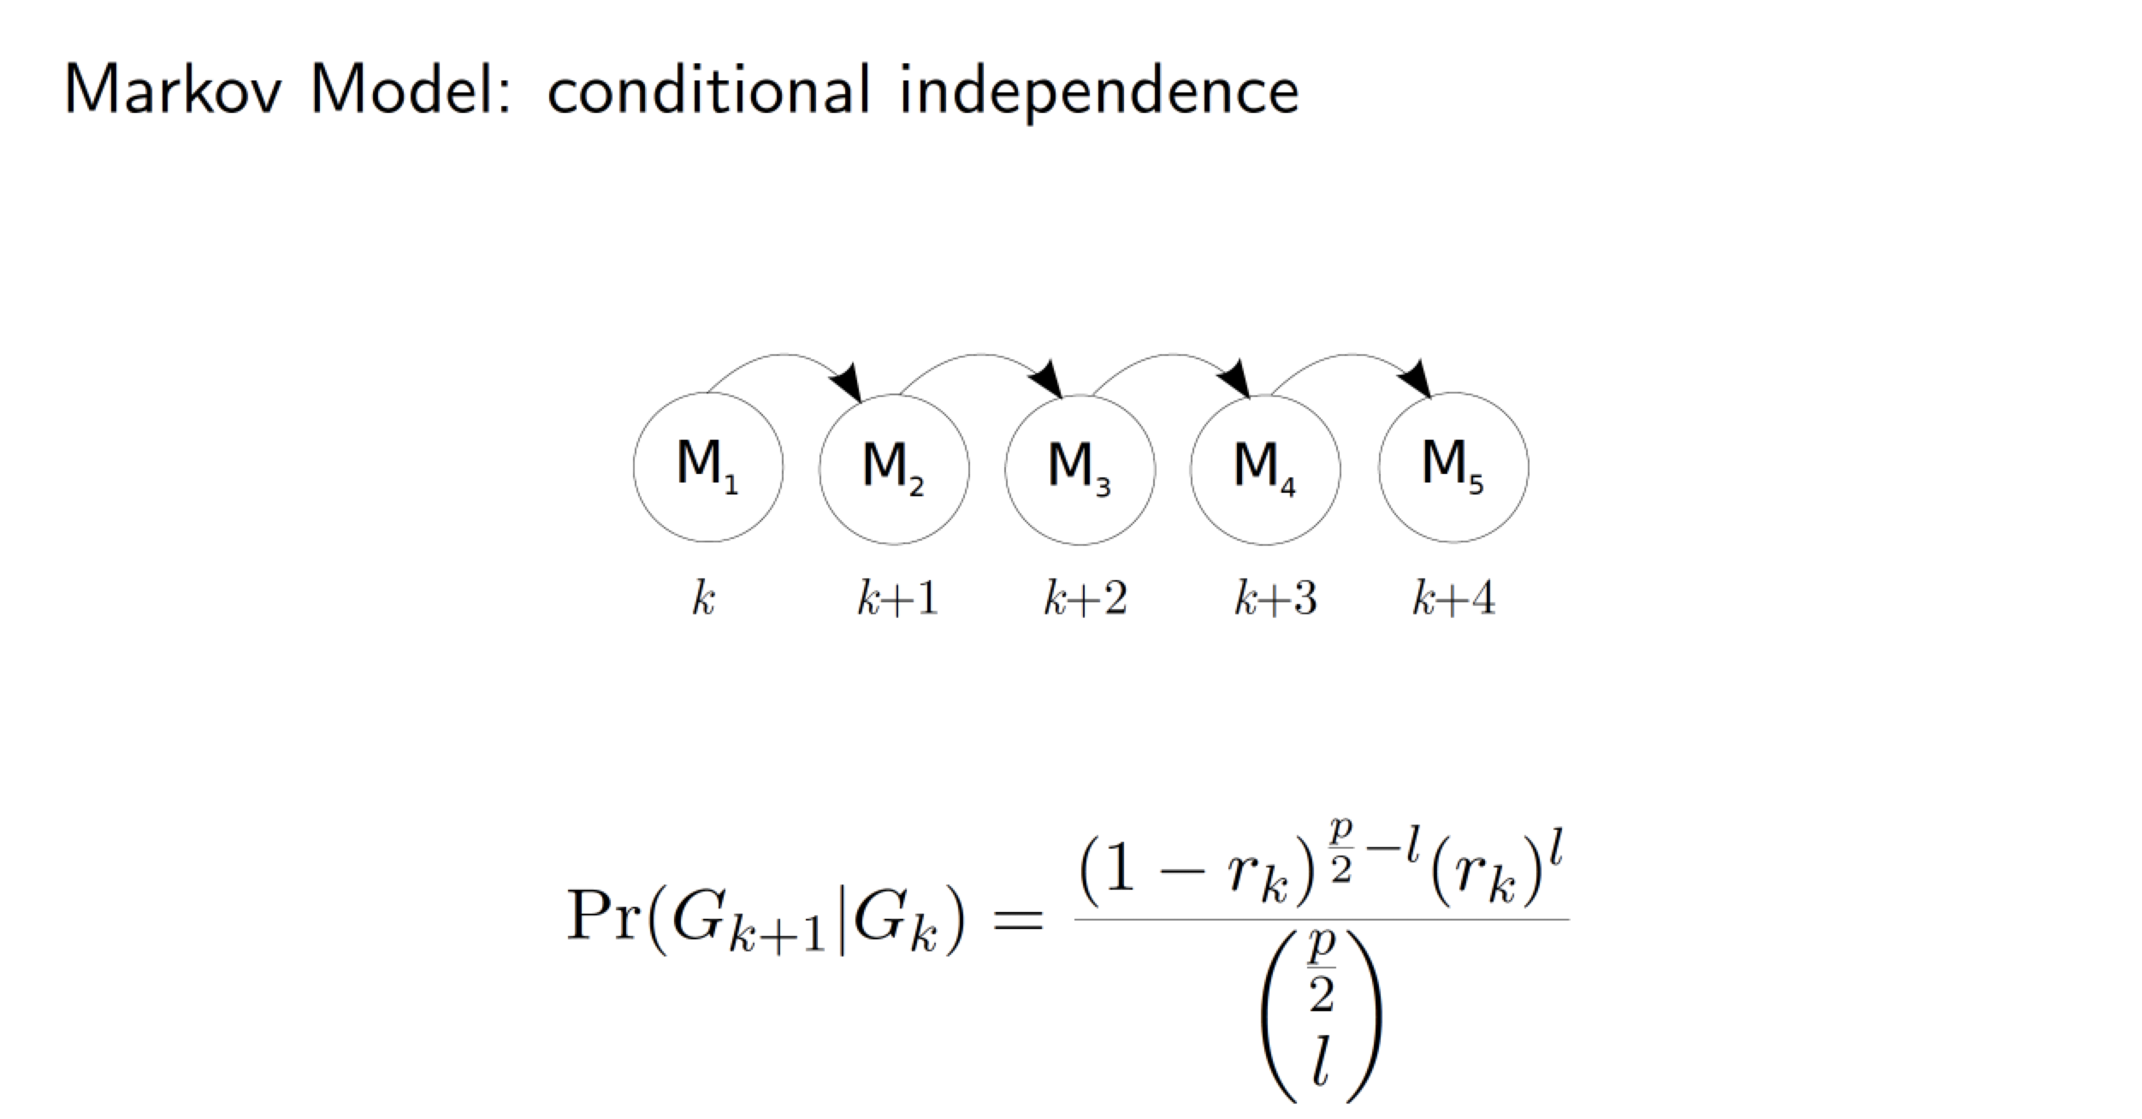
Multilocus linkage analysis in polyploids
where r_{k} is the recombination frequency between loci k and k+1, p is the ploidy level and l is the number of recombinant events between k and k+1.
Leach et al. (2010) doi:10.1073/pnas.0908477107
Mollinari and Garcia (2019) doi:10.1534/g3.119.400378

Slide 19
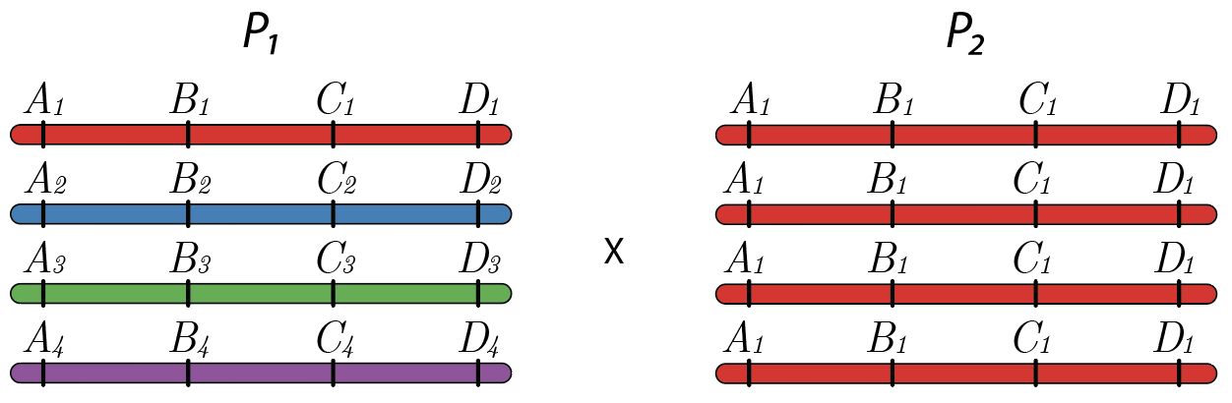
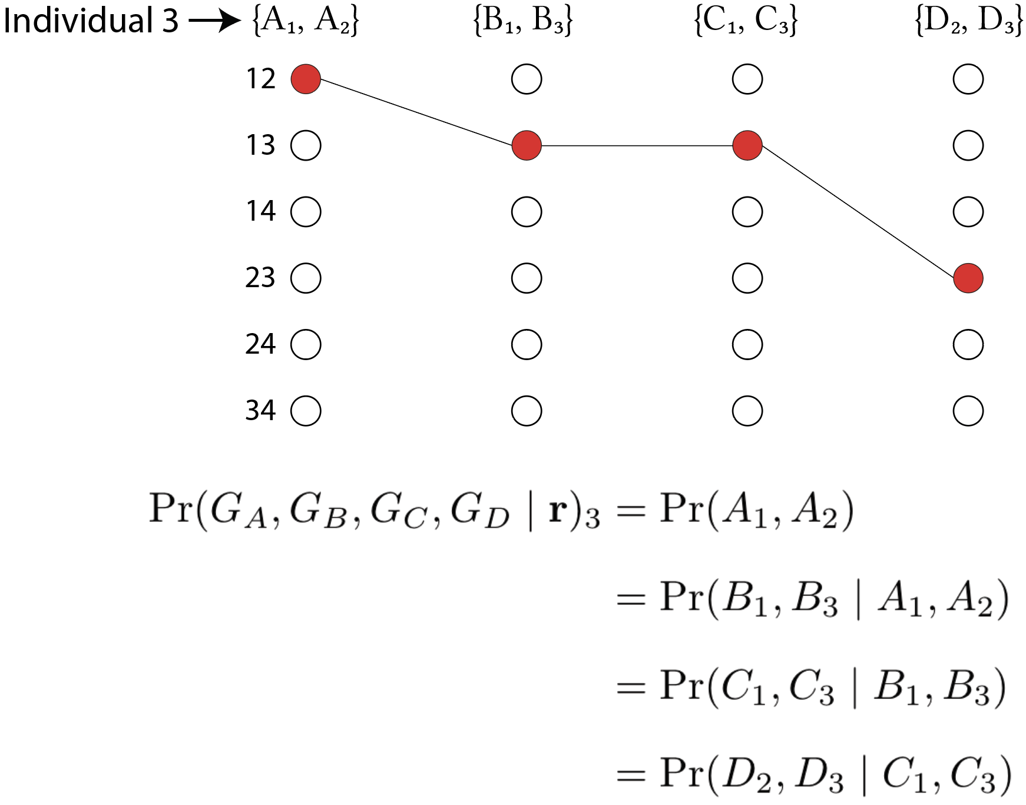
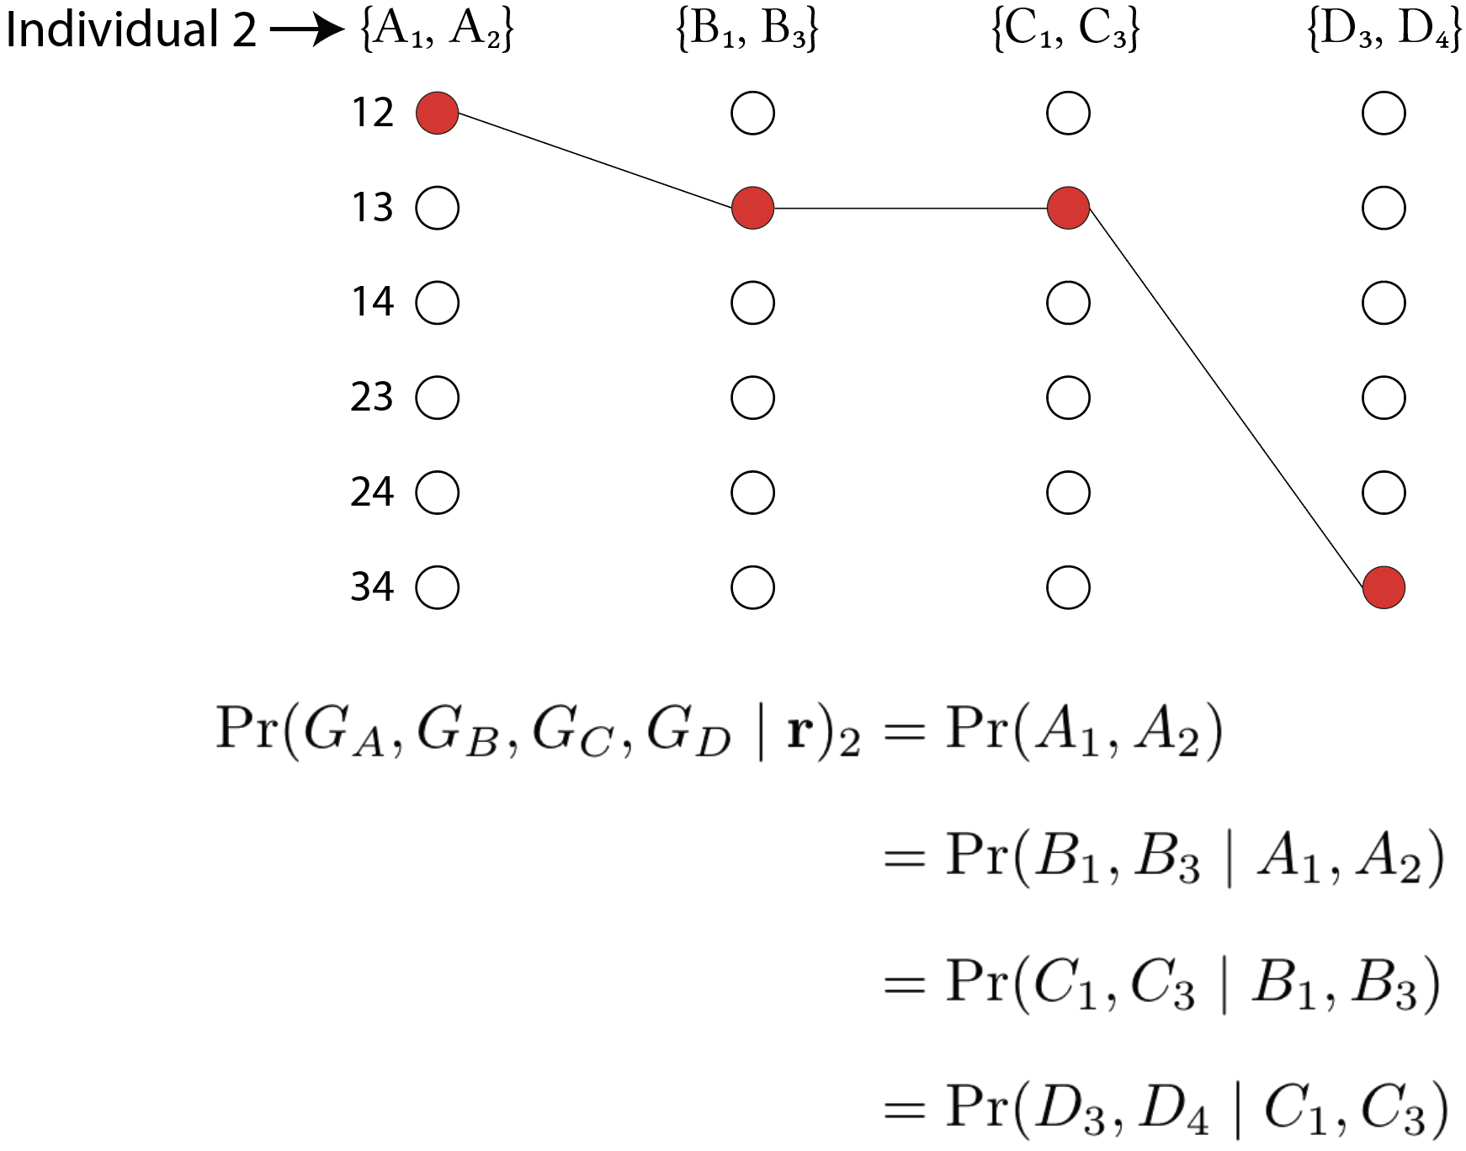
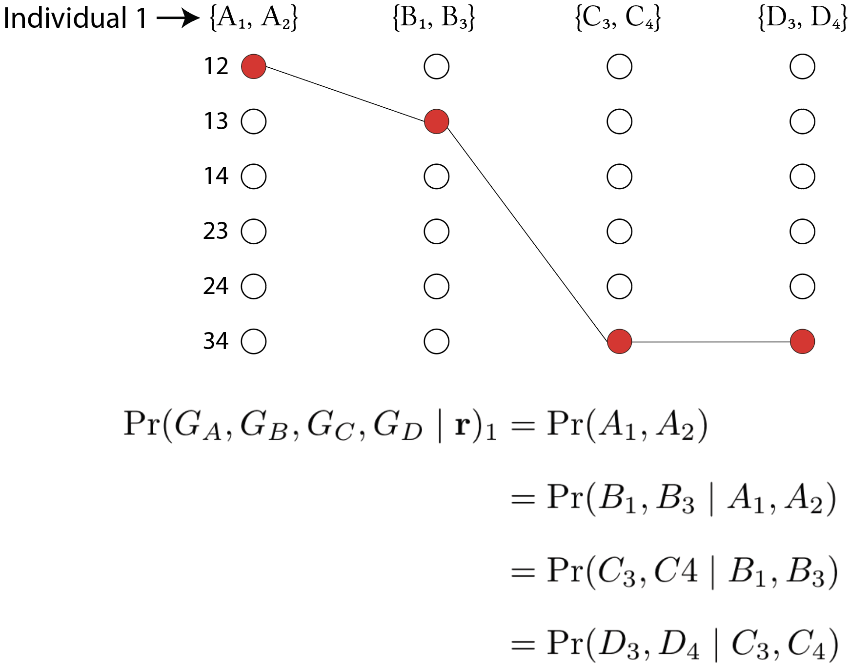
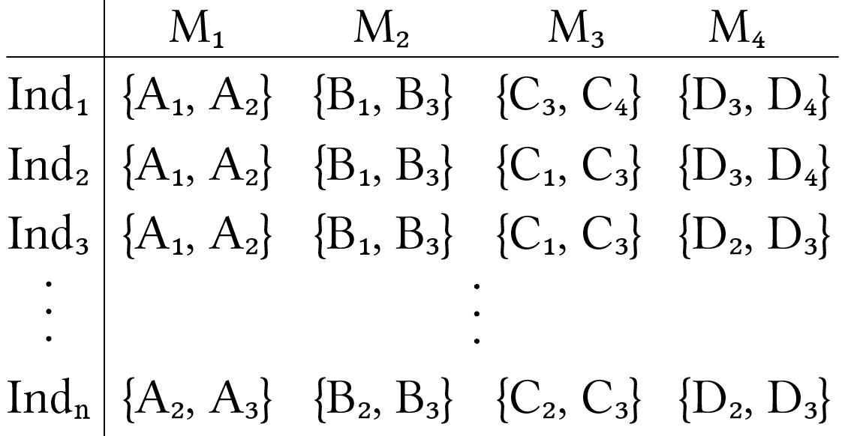
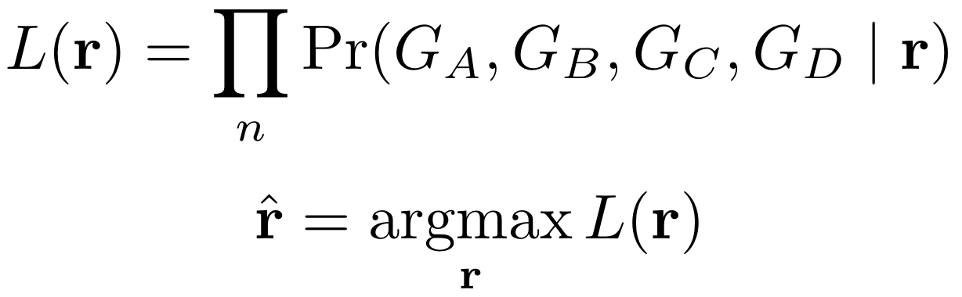
Markov model

Slide 20
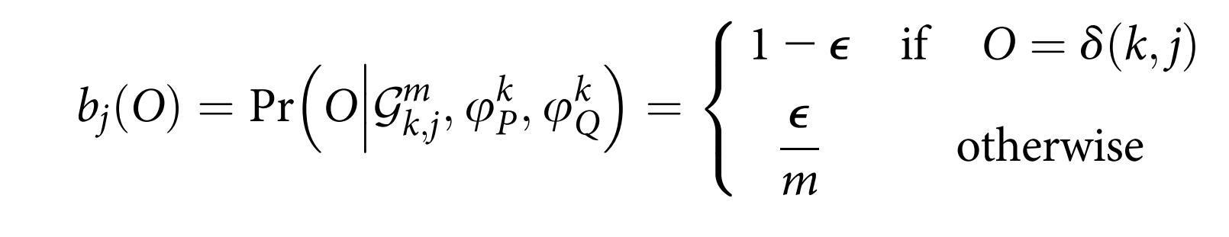










Hidden Markov Model - HMM

Slide 21


Hidden Markov Model - HMM
Assessing different linkage phases using multilocus analysis

Slide 22

Hidden Markov Model - HMM
Tetraploid example, one individual, 15 markers
1 1 1 3 1 1 2 2 0 1 2 1 1 0 1

Slide 23

Hidden Markov Model - HMM
Tetraploid example, one individual, 15 markers
1 1 1 3 1 1 2 2 0 1 2 1 1 0 1

Slide 24

Haplotype phasing – MAPpoly strategy
Step 1: Use of two-point information to reduce the search space
Step 2: Evaluate the remaining configurations, using HMM likelihood

Slide 25
Local haplotyping in polyploids
The information is assessed at SNP level (essentially biallelic).
It is not possible to distinguish more than two subsets of homologs.
Combining information of several SNPs result in haplotype-based markers
Mitigate genotyping errors (posterior state probabilities)

Slide 26

Sweetpotato genetic map
Mollinari et al. (2020)
doi:10.1534/g3.119.400620

Slide 27
Sweetpotato genetic map

Slide 28


Probabilistic haplotype reconstruction
When assuming a prior probability distribution of the genotypes, multilocus strategies can improve the quality of the inferred haplotypes
Tetraploid potato

Slide 29


Probabilistic haplotype reconstruction
Hexaploid sweetpotato

Slide 30
References
Haldane, J. Theoretical Genetics of Autopolyploids. J. Genet. 22, 359–372 (1930).
Mather, K. Reductional and equational separation of the chromosomes in bivalents and multivalents. J. Genet. 30, 53–78 (1935).
Mather, K. Segregation and linkage in autotetraploids. J. Genet. 32, 287–314 (1936).
Mather, K. The measurement of linkage in heredity. (1938).
Fisher, R. A. The theory of linkage in polysomic inheritance. Philos. Trans. R. Soc. Lond. B. Biol. Sci. 233, 55–87 (1947).
Ripol, M. I., Churchill, G. A., Silva, J. A. G. Da & Sorrells, M. Statistical aspects of genetic mapping in autopolyploids. Gene 235, 31–41 (1999).
Luo, Z. W., Zhang, R. M. & Kearsey, M. J. Theoretical basis for genetic linkage analysis in autotetraploid species. Proc. Natl. Acad. Sci. U. S. A. 101, 7040–7045 (2004).
Leach, L. J., Wang, L., Kearsey, M. J. & Luo, Z. Multilocus tetrasomic linkage analysis using hidden Markov chain model. Proc. Natl. Acad. Sci. U. S. A. 107, 4270–4274 (2010).
Hackett, C. a., McLean, K. & Bryan, G. J. Linkage Analysis and QTL Mapping Using SNP Dosage Data in a Tetraploid Potato Mapping Population. PLoS One 8, (2013).
Zheng, C. et al. Probabilistic Multilocus Haplotype Reconstruction in Outcrossing Tetraploids. Genetics 203, 119–131 (2016).
Bourke, P. M. Genetic mapping in polyploids. (Wageningen University, 2018).
Mollinari, M. & Garcia, A. A. F. Linkage Analysis and Haplotype Phasing in Experimental Autopolyploid Populations with High Ploidy Level Using Hidden Markov Models. G3; Genes|Genomes|Genetics 9, 3297–3314 (2019).

